Slide 1
Quant Methods for HSR I
Lecture 4: Getting Fancier with Regression
January 26, 2025 (makeup: Feb. 2, 2026)
HAD5744 • Alex Hoagland, Ph.D.
Notes:
Housekeeping:
Go over adapted schedule given snow day and small class
Next week’s class will be about data cleaning and research designs (broadly), so please come with your research questions at least half-baked, so we can talk specifics.
Project proposal ideas coming up by Feb. 23. Also make sure to watch the correct (old) version of the video so we can talk about this (only need to watch parts 1 through 3).
What do you do if you don’t have a question? Read through the data dictionaries here, then do some descriptive work! And also watch the video for next week, thinking about your questions!

Slide 2
Other Options with Regressions
There are multiple other things that can be done with a regression
Regression is a very flexible tool
In class, we’ll cover:
Options for variables (scaling & transformations)
Interactions
Nonlinear effects which are linear in parameters (if there’s time)
Notes on standard errors
Notes on interpreting regressions with covariates as causal
Later, we’ll cover more nonlinear regression options:
Binary outcome variables (probit/logit)
General nonparametric approaches
Notes:
Note: does any of this fix the selection issues? No! But it can improve precision, aid in interpretation, and ensure that you are getting your associations correct.

Slide 3
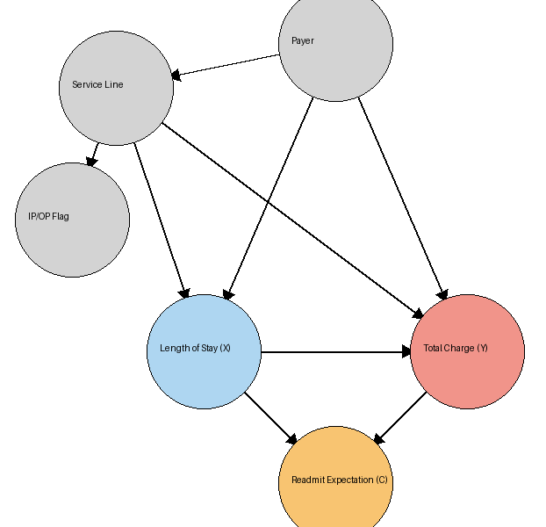
Assignment 1 Notes
Notes:
Grades for assignments out, videos coming ASAP
Overall, nice work! Let me know if your comments are confusing to you, happy to chat more in office hours as well. Remember that we are prioritizing interpretation and writing about our results as much as producing the actual code! This is a *critical* skill to develop.
DAGs (note: I had trouble getting GPT to do this correctly?): make sure that you think about arrows between observed and unobserved covariates. What stands out here?
Note: what’s omitted here (severity)? How would that bias your coefficient?

Slide 4
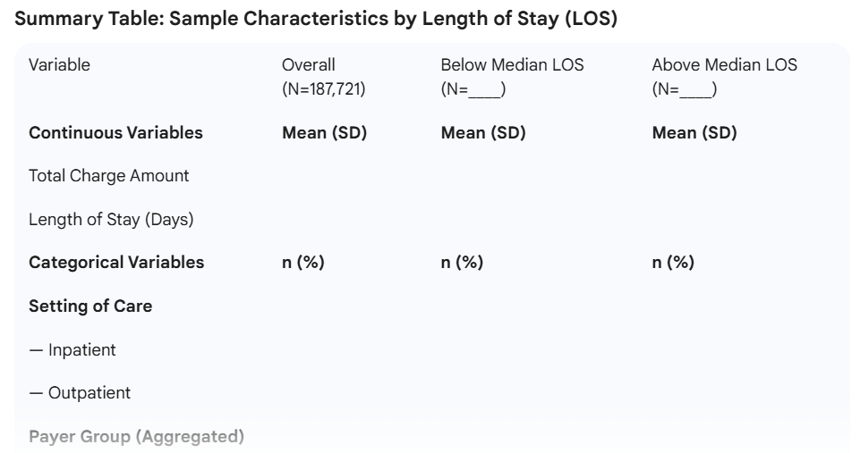
Assignment 1 Notes
Notes:
I thought the tables all looked pretty good, something like this might have helped “tell the story” in a paper. (For example, it could have at least shown the need to match?)

Slide 5
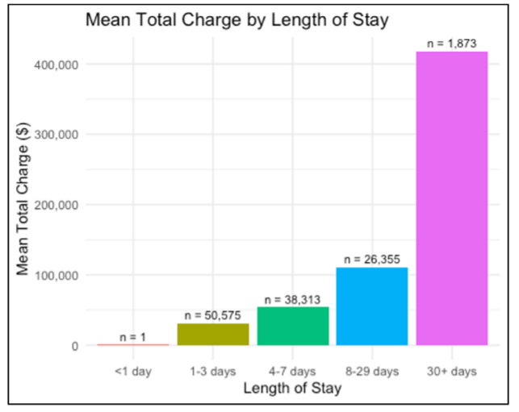
Assignment 1 Notes
Notes:
Some really nice data visualizations from one of the project teams!

Slide 6
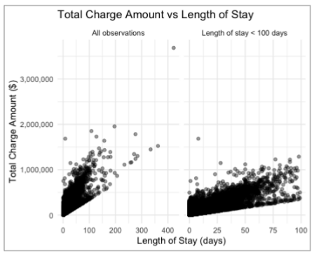
Assignment 1 Notes
Notes:
Some really nice data visualizations from one of the project teams! What happens when you zoom in here?
For Assignment 2, you are welcome to modify your data cleaning assumptions as you see fit. Should be able to complete everything by the end of class. One thing that is missing from Assignment 2 (for brevity) but that I encourage you to think about – what needs a log transform here, if anything?

Slide 7
Case Study: “Observational Studies of the Effect of Medicaid on Health: Controls Are Not Enough”
Seth Freedman, Andrew Goodman-Bacon, and Noah Hammarlund
Journal of Labor Economics, 2021

Slide 8
What is the setting of this paper? Why is it important?
Notes:
We care about whether government policy actually affects health. Example here: Medicaid in the US. These results matter because Medicaid costs half a trillion dollars per year and is among the most expensive items in federal and state budgets

Slide 9
What is the setting of this paper? Why is it important?
What is this paper arguing?

Slide 10
What is the setting of this paper? Why is it important?
What is this paper arguing?
Cross-sectional studies have found a lot of different results
Some argue Medicaid patients have worse outcomes compared to nonrecipients
Others use “plausibly exogenous” changes in Medicaid coverage and find benefits
Are there RCTs? What did they find?
Notes:
We care about whether government policy actually affects health. Example here: Medicaid in the US.

Slide 11
What is the setting of this paper? Why is it important?
What is this paper arguing?
Why is it difficult to find a good causal effect?
What are the identification threats here?
What is needed to identify a causal effect using only controls?
What is this paper going to show (broad strokes)?
Where would this paper be applicable to Canadian health systems researchers?
Notes:
The primary one is selection across treatment and any plausible “control” group. Conditional on income (qualifying for Medicaid), those who have worse health are more likely to actually enrol. So you’re not comparing apples and oranges to look at recipients and nonrecipients.
- Other problems include missing data in your admin datasets (income, like last time), and private information to participants that we don’t have.
“To interpret the adjusted differences as causal effects, the control variables must completely account for factors that make patients less healthy and lead them to qualify for and take up Medicaid coverage.” (the last bit is the hardest to control for)
The paper will replicate a big finding of the day, toy with the model (add more controls), and then examine how selection could contribute to this difference.

Slide 12
Variable Selection: Transformations
Notes:
First, let’s introduce a few more ideas.

Slide 13
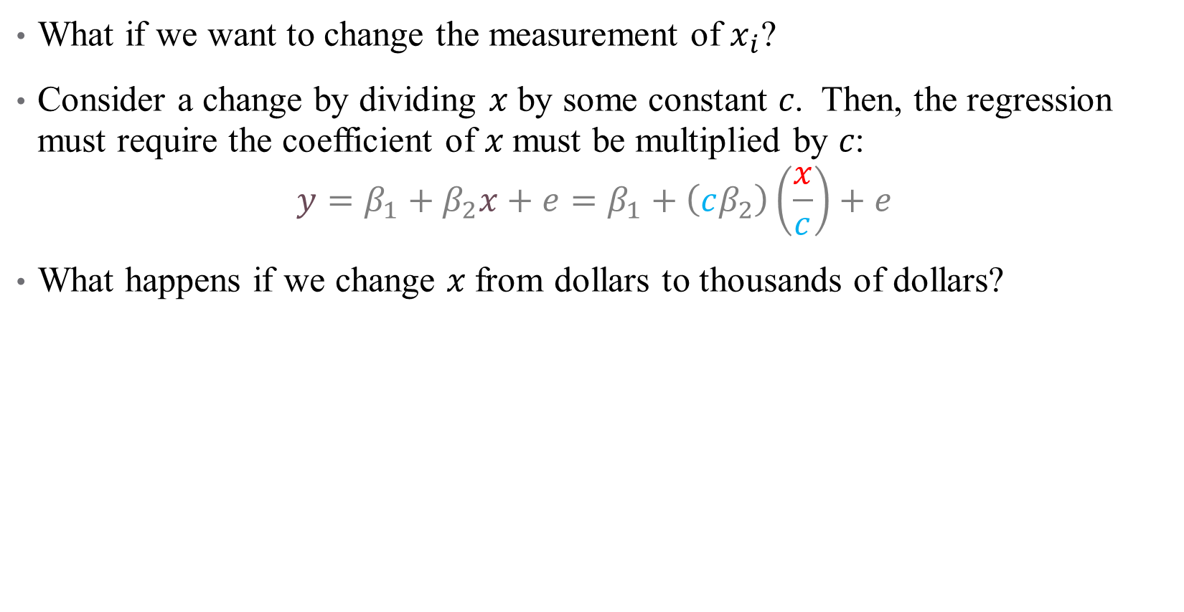
Scaling Regressors
What if we want to change the measurement of $x_{i}$?
Consider a change by dividing 𝑥 by some constant 𝑐. Then, the regression must require the coefficient of 𝑥 must be multiplied by 𝑐:
$$y=β_{1}+β_{2}x+e=β_{1}+\left(cβ_{2}\right)\left(\frac{x}{c}\right)+e$$
What happens if we change 𝑥 from dollars to thousands of dollars?
Notes:
This is directly related to the idea that if beta is the ME of 1, then the ME of 100 is 100*beta. May come in useful for your homework assignment – feel free to rescale variables as desired.

Slide 14
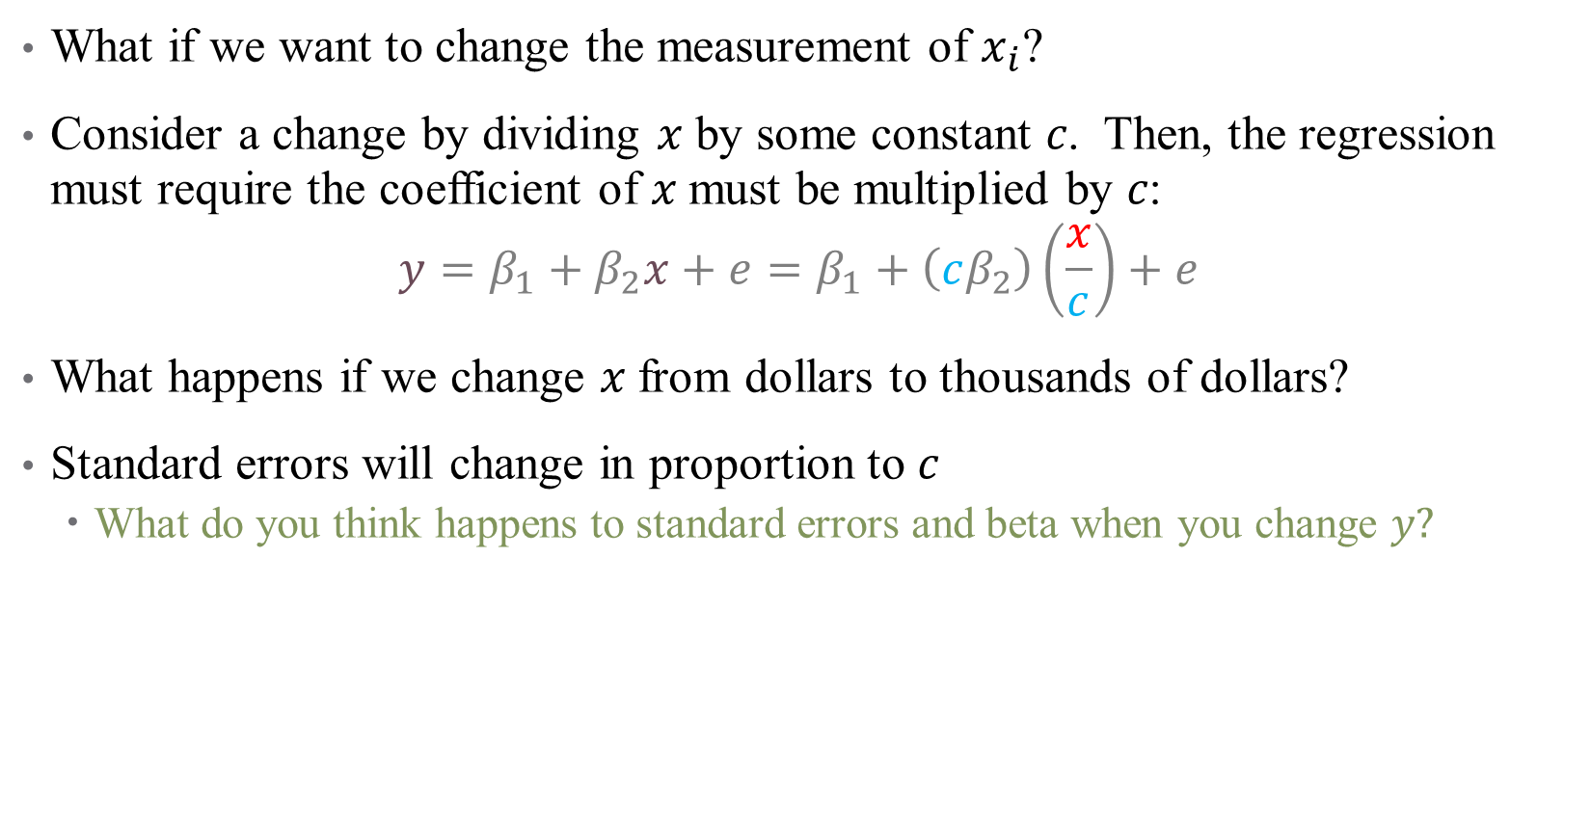
Scaling Regressors
What if we want to change the measurement of $x_{i}$?
Consider a change by dividing 𝑥 by some constant 𝑐. Then, the regression must require the coefficient of 𝑥 must be multiplied by 𝑐:
$$y=β_{1}+β_{2}x+e=β_{1}+\left(cβ_{2}\right)\left(\frac{x}{c}\right)+e$$
What happens if we change 𝑥 from dollars to thousands of dollars?
Standard errors will change in proportion to $c$
What do you think happens to standard errors and beta when you change $y?$
Notes:
They all change by the same amount

Slide 15
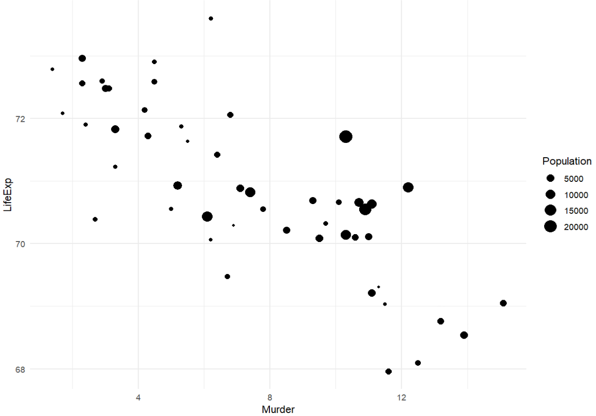
Scaling Observations
Should every observation count the same?
Food insecurity
Notes:
Briefly mention scaling regressors, which we talked about last time. Here, each point is a state in the US; do we want all states to be counted equally in our regression?

Slide 16
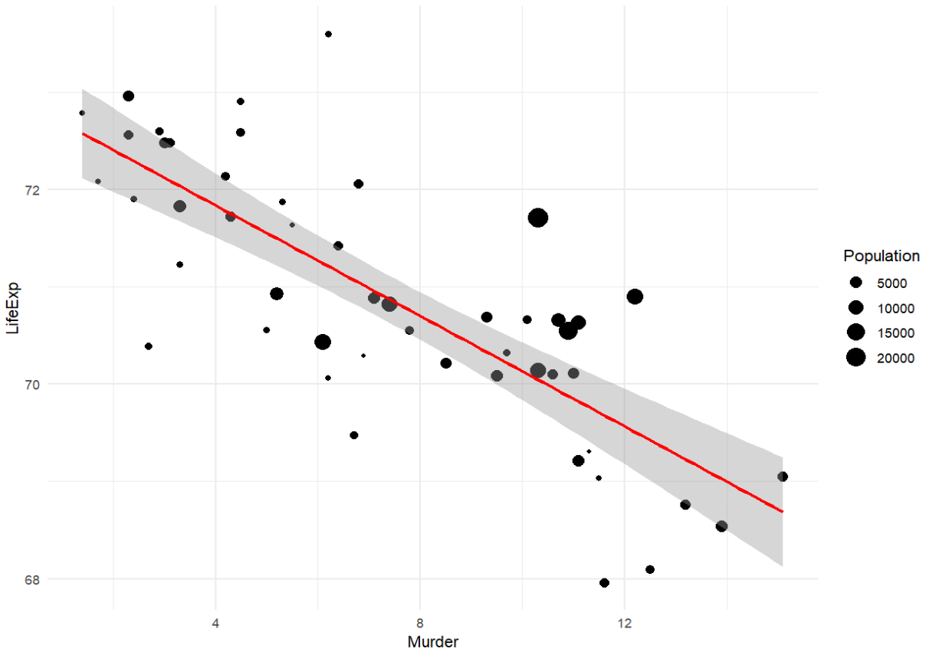
Scaling Observations
What if instead, we want to weight our observations differently?
Food insecurity
Notes:
This is without smoothing

Slide 17
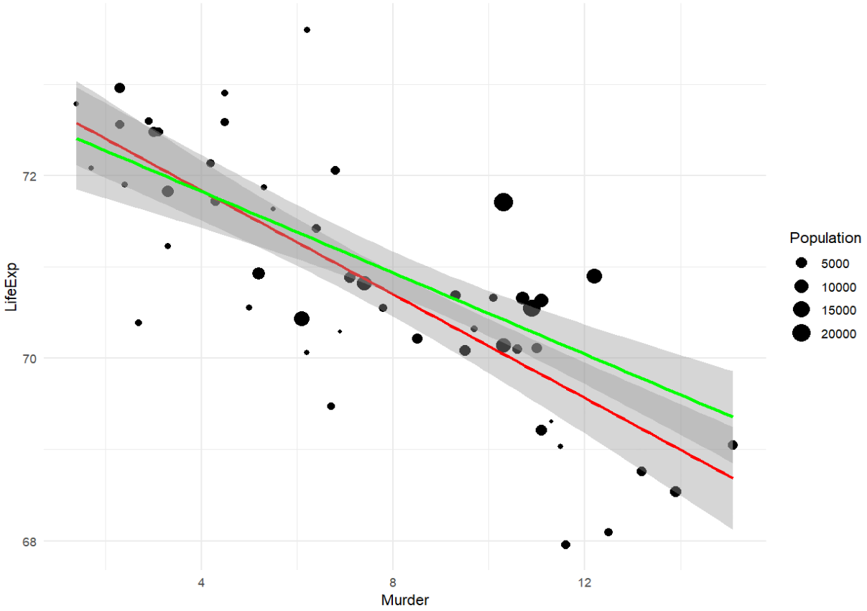

Scaling Observations
What if instead, we want to weight our observations differently?
Food insecurity
Notes:
So what is the difference? Are we over-stating or under-stating the true effect here without the weighting (overstating, the line is steeper)
What causes the differences here?
Note: does our case study use weighting? Yes! By the NIS provided discharge weight to make procedures nationally representative.

Slide 18
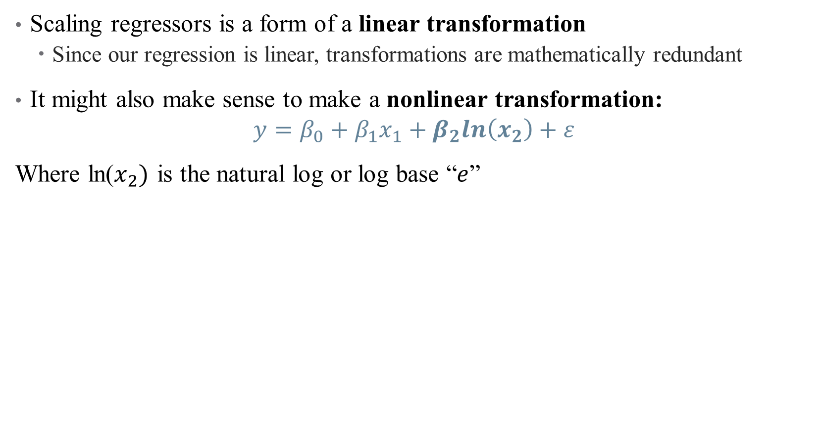
Nonlinear Transformations
Scaling regressors is a form of a linear transformation
Since our regression is linear, transformations are mathematically redundant
It might also make sense to make a nonlinear transformation:
$$y=β_{0}+β_{1}x_{1}+β_{2}ln\left(x_{2}\right)+ε$$
Where ln($x_{2})$ is the natural log or log base “$e$”
Notes:
We talked about this last week

Slide 19
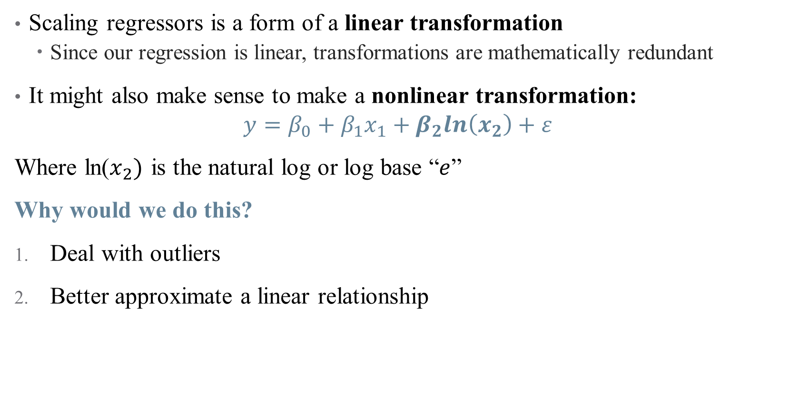
Nonlinear Transformations
Scaling regressors is a form of a linear transformation
Since our regression is linear, transformations are mathematically redundant
It might also make sense to make a nonlinear transformation:
$$y=β_{0}+β_{1}x_{1}+β_{2}ln\left(x_{2}\right)+ε$$
Where ln($x_{2})$ is the natural log or log base “$e$”
Why would we do this?
Deal with outliers
Better approximate a linear relationship

Slide 20
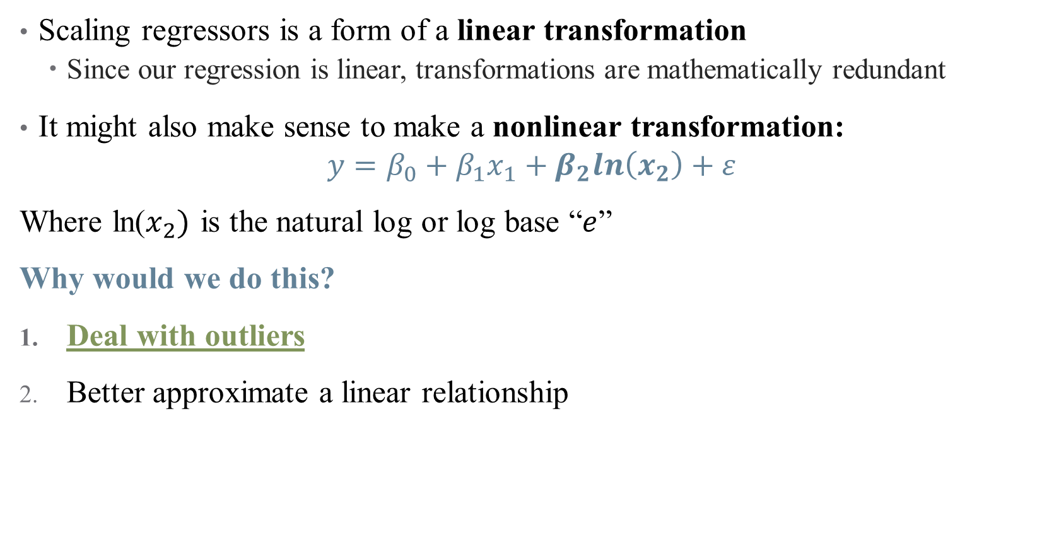
Nonlinear Transformations
Scaling regressors is a form of a linear transformation
Since our regression is linear, transformations are mathematically redundant
It might also make sense to make a nonlinear transformation:
$$y=β_{0}+β_{1}x_{1}+β_{2}ln\left(x_{2}\right)+ε$$
Where ln($x_{2})$ is the natural log or log base “$e$”
Why would we do this?
Deal with outliers
Better approximate a linear relationship

Slide 21
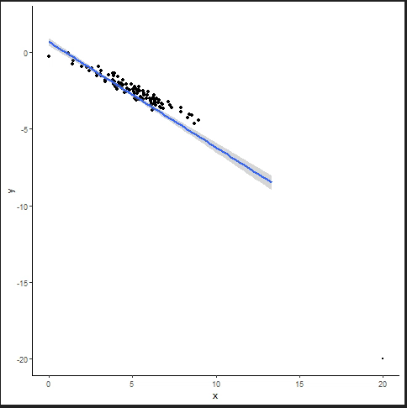
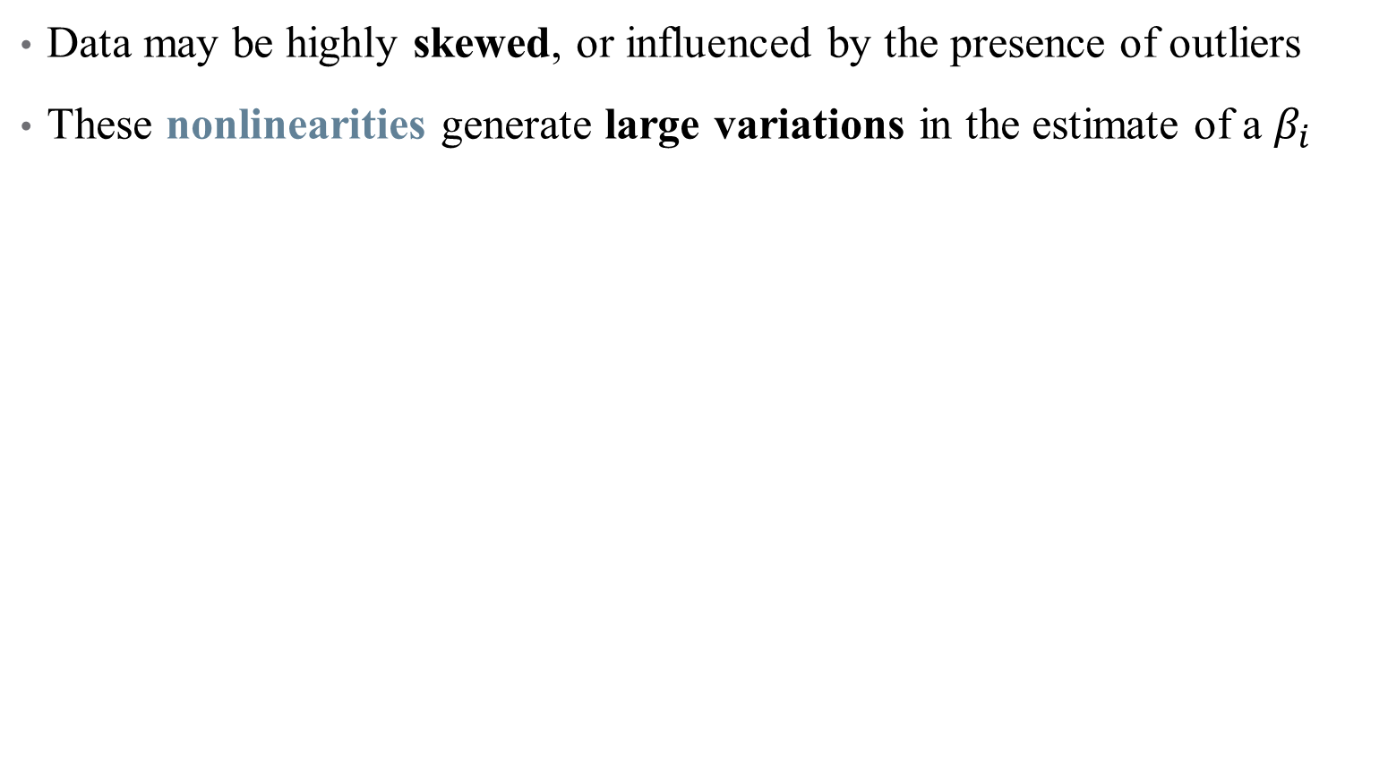
Nonlinear Transformations: Outliers
Data may be highly skewed, or influenced by the presence of outliers
These nonlinearities generate large variations in the estimate of a $β_{i}$
Notes:
Example: income distribution

Slide 22
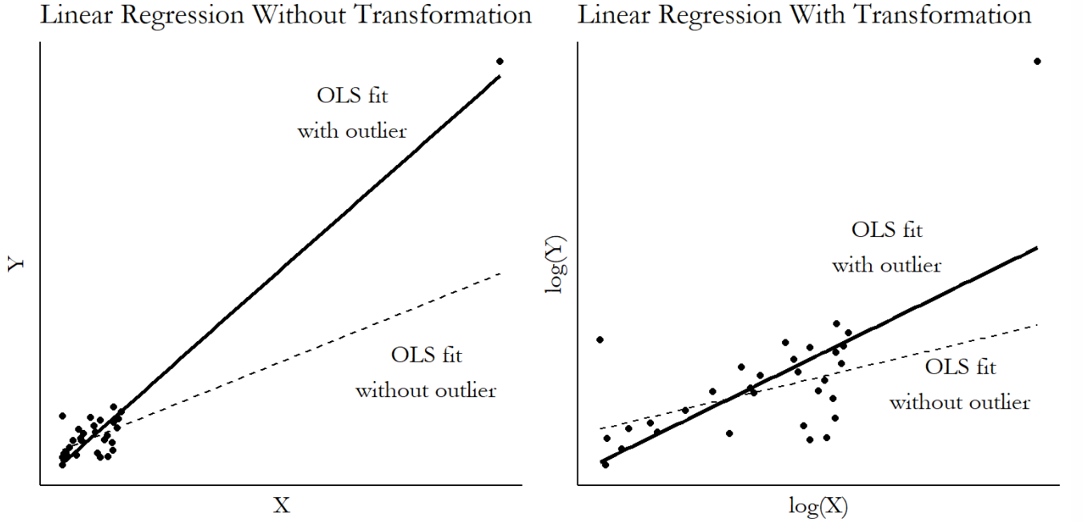
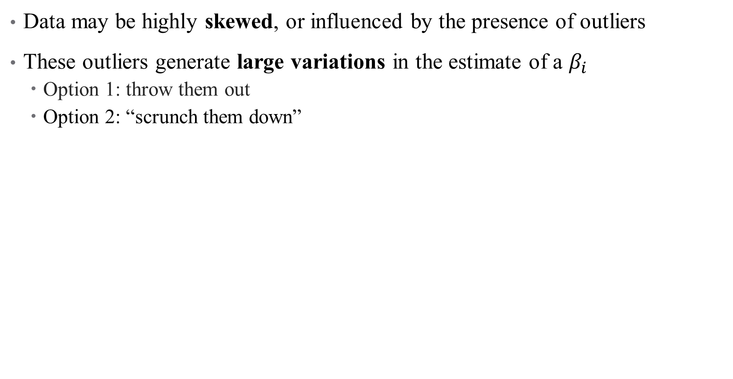
Nonlinear Transformations: Outliers
Data may be highly skewed, or influenced by the presence of outliers
These outliers generate large variations in the estimate of a $β_{i}$
Option 1: throw them out
Option 2: “scrunch them down”
Notes:
What does it mean to get selective with your data? That’s a bold move.

Slide 23
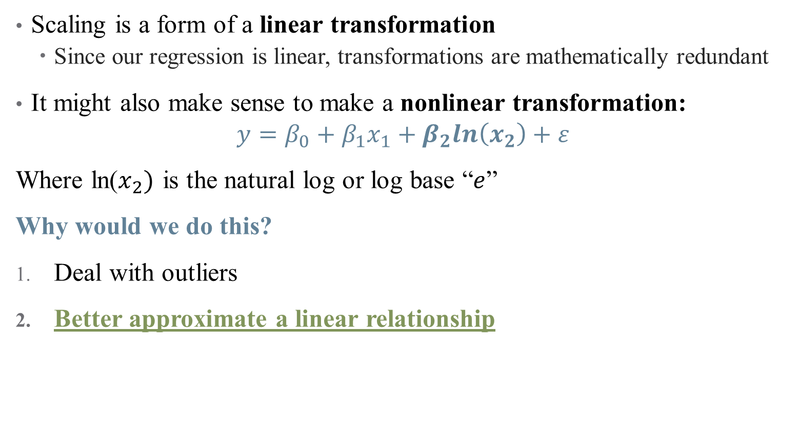
Nonlinear Transformations
Scaling is a form of a linear transformation
Since our regression is linear, transformations are mathematically redundant
It might also make sense to make a nonlinear transformation:
$$y=β_{0}+β_{1}x_{1}+β_{2}ln\left(x_{2}\right)+ε$$
Where ln($x_{2})$ is the natural log or log base “$e$”
Why would we do this?
Deal with outliers
Better approximate a linear relationship
Notes:
This is all about interpretation – what does it mean to interpret a single marginal effect if the distribution is wonky? Change from 10000 to 20000 annually versus change from 200000 to 210000

Slide 24
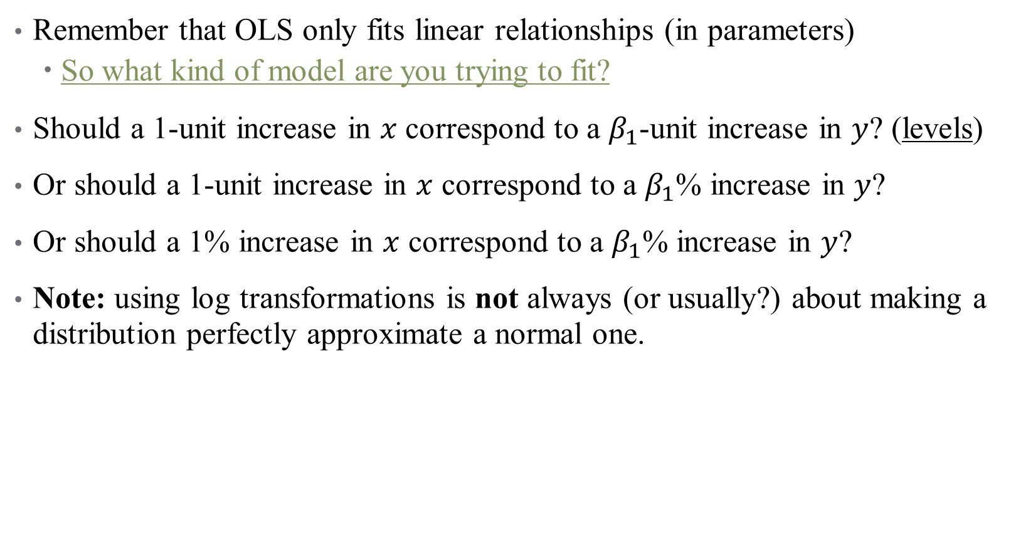
Nonlinear Transformations: Achieving “Linearity” (?)
Remember that OLS only fits linear relationships (in parameters)
So what kind of model are you trying to fit?
Should a 1-unit increase in $x$ correspond to a $β_{1}$-unit increase in $y$? (levels)
Or should a 1-unit increase in $x$ correspond to a $β_{1}$% increase in $y$?
Or should a 1% increase in $x$ correspond to a $β_{1}$% increase in $y$?
Note: using log transformations is not always (or usually?) about making a distribution perfectly approximate a normal one.

Slide 25
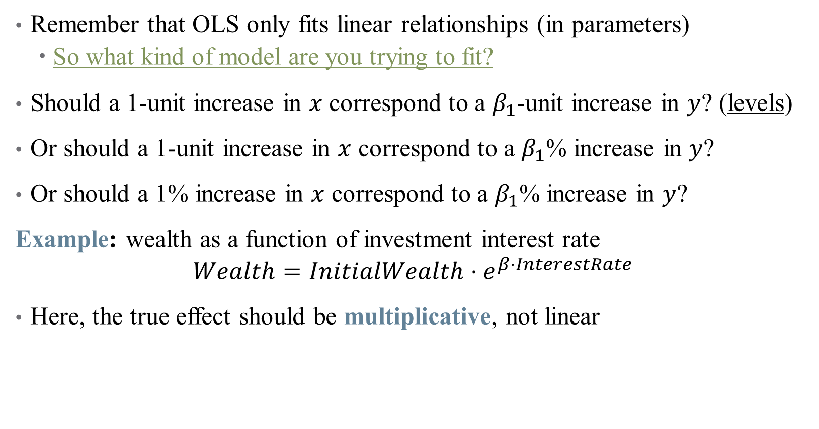
Nonlinear Transformations: Achieving “Linearity” (?)
Remember that OLS only fits linear relationships (in parameters)
So what kind of model are you trying to fit?
Should a 1-unit increase in $x$ correspond to a $β_{1}$-unit increase in $y$? (levels)
Or should a 1-unit increase in $x$ correspond to a $β_{1}$% increase in $y$?
Or should a 1% increase in $x$ correspond to a $β_{1}$% increase in $y$?
Example: wealth as a function of investment interest rate
$$Wealth=InitialWealth⋅e^{β⋅InterestRate}$$
Here, the true effect should be multiplicative, not linear
Notes:
How to get this in a regression? Use the natural log! Do this on the board.

Slide 26
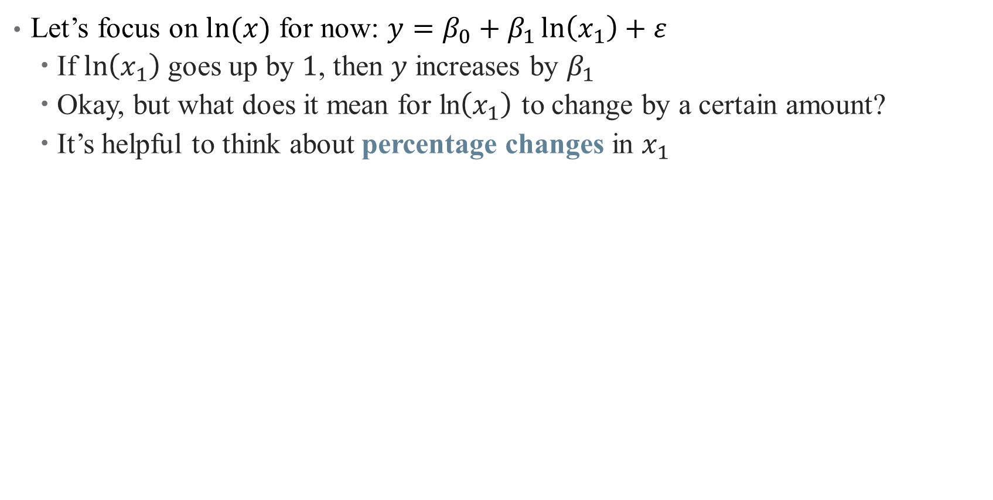
How to interpret coefficients on transformed variables?
Let’s focus on $ln⁡(x)$ for now: $y=β_{0}+β_{1}\ln\left(x_{1}\right)+ε$
If $\ln\left(x_{1}\right)$ goes up by $1$, then $y$ increases by $β_{1}$
Okay, but what does it mean for ln$\left(x_{1}\right)$ to change by a certain amount?
It’s helpful to think about percentage changes in $x_{1}$

Slide 27
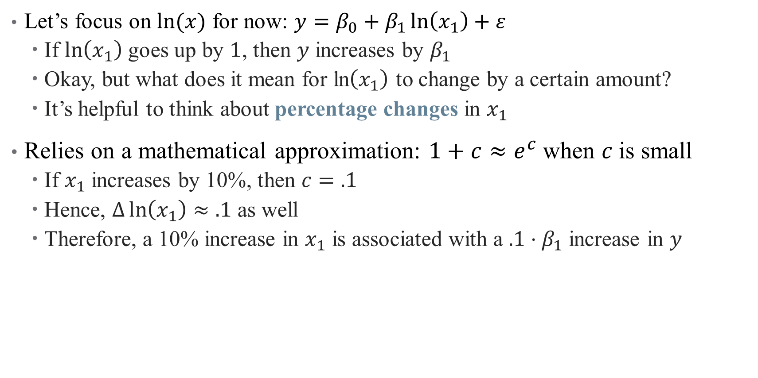
How to interpret coefficients on transformed variables?
Let’s focus on $ln⁡(x)$ for now: $y=β_{0}+β_{1}\ln\left(x_{1}\right)+ε$
If $\ln\left(x_{1}\right)$ goes up by $1$, then $y$ increases by $β_{1}$
Okay, but what does it mean for ln$\left(x_{1}\right)$ to change by a certain amount?
It’s helpful to think about percentage changes in $x_{1}$
Relies on a mathematical approximation: $1+c≈e^{c}$when $c$is small
If $x_{1}$ increases by 10%, then $c=.1$
Hence, $Δ\ln\left(x_{1}\right)≈.1$ as well
Therefore, a 10% increase in $x_{1}$ is associated with a $.1⋅β_{1}$ increase in $y$

Slide 28
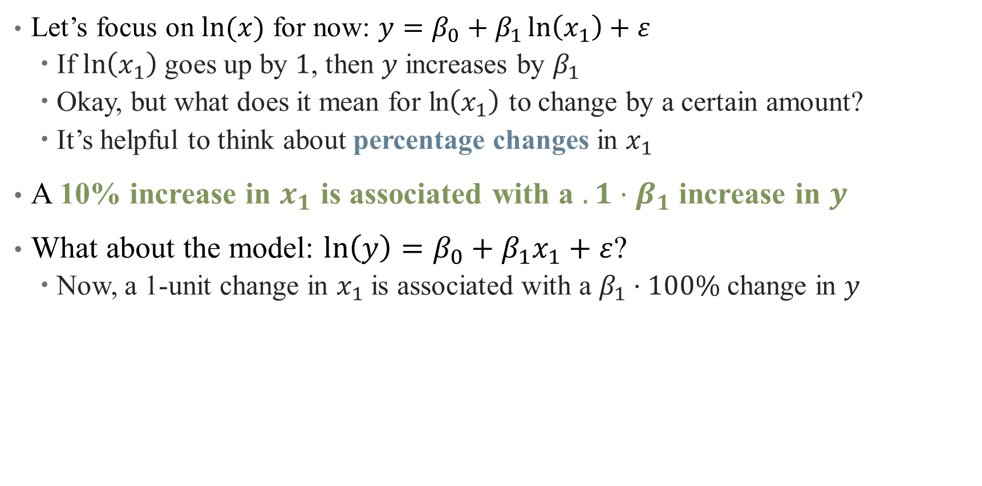
How to interpret coefficients on transformed variables?
Let’s focus on $ln⁡(x)$ for now: $y=β_{0}+β_{1}\ln\left(x_{1}\right)+ε$
If $\ln\left(x_{1}\right)$ goes up by $1$, then $y$ increases by $β_{1}$
Okay, but what does it mean for ln$\left(x_{1}\right)$ to change by a certain amount?
It’s helpful to think about percentage changes in $x_{1}$
A 10% increase in $x_{1}$ is associated with a $.1⋅β_{1}$ increase in $y$
What about the model: $ln\left(y\right)=β_{0}+β_{1}x_{1}+ε$?
Now, a 1-unit change in $x_{1}$ is associated with a $β_{1}⋅100\%$ change in $y$
Notes:
Just the same as before, but one of the variables is in percent and one is in levels – just depends which one you want

Slide 29
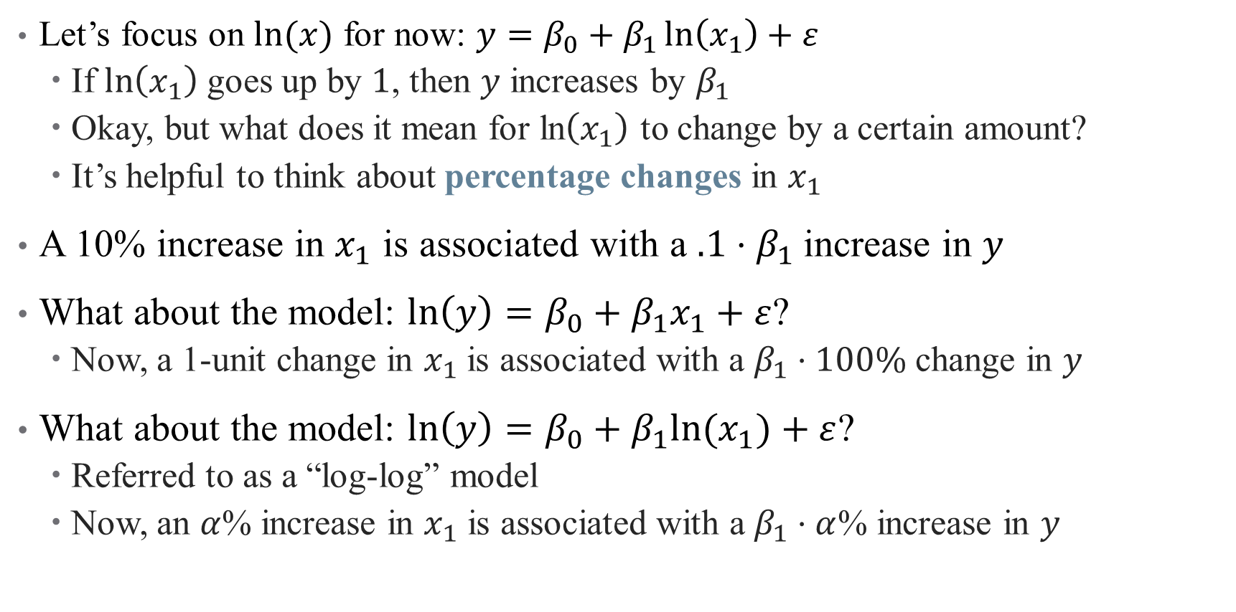
How to interpret coefficients on transformed variables?
Let’s focus on $ln⁡(x)$ for now: $y=β_{0}+β_{1}\ln\left(x_{1}\right)+ε$
If $\ln\left(x_{1}\right)$ goes up by $1$, then $y$ increases by $β_{1}$
Okay, but what does it mean for ln$\left(x_{1}\right)$ to change by a certain amount?
It’s helpful to think about percentage changes in $x_{1}$
A 10% increase in $x_{1}$ is associated with a $.1⋅β_{1}$ increase in $y$
What about the model: $ln\left(y\right)=β_{0}+β_{1}x_{1}+ε$?
Now, a 1-unit change in $x_{1}$ is associated with a $β_{1}⋅100\%$ change in $y$
What about the model: $ln\left(y\right)=β_{0}+β_{1}{ln⁡(x}_{1})+ε$?
Referred to as a “log-log” model
Now, an $α$% increase in $x_{1}$ is associated with a $β_{1}⋅α$% increase in $y$
Notes:
This is the version where both are in percentages.
Quick example on logs: suppose we do
y=bx, where b=5. Then how do we interpret?
Y=b*log(x) where b = 5. Then a 1% increase in x corresponds to a 5*.01 = 0.05 unit increase in y
Log(y) = b*x where b = 5. Then a 1 unit increase in x corresponds to a 500% (5-fold increase) in y
Log(y) = b*log(x). Then a 1% increase in x corresponds to a 0.05 increase in log(y), so roughly a 5% increase in y.

Slide 30
What kinds of transformations exist?
See “The Effect” for a (more) exhaustive list (pg. 214)
Natural Log – tried and true
But, recall that ln(0) is undefined – what if we have zero-valued data?

Slide 31
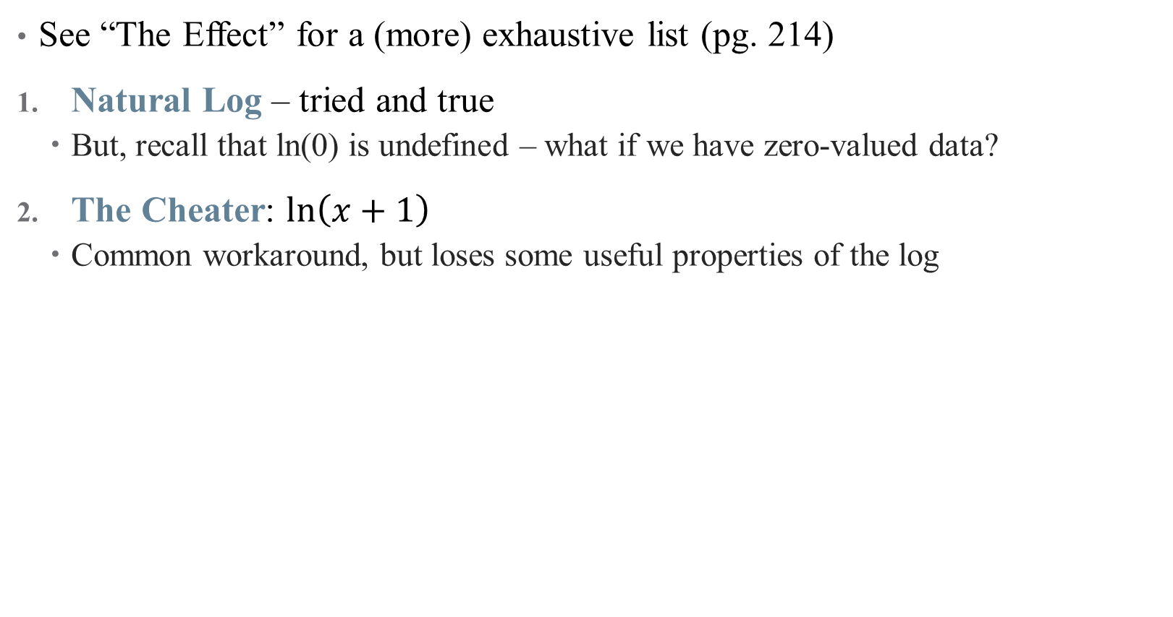
What kinds of transformations exist?
See “The Effect” for a (more) exhaustive list (pg. 214)
Natural Log – tried and true
But, recall that ln(0) is undefined – what if we have zero-valued data?
The Cheater: $ln\left(x+1\right)$
Common workaround, but loses some useful properties of the log
Notes:
If x is large, log(x+1) \approx. log(x). So this works for like health spending or income data, and is defined for 0s. Hence, percentages don’t really work for small x.
There are others, sinh^{-1}, square root, etc. (coming up in a few slides)

Slide 32
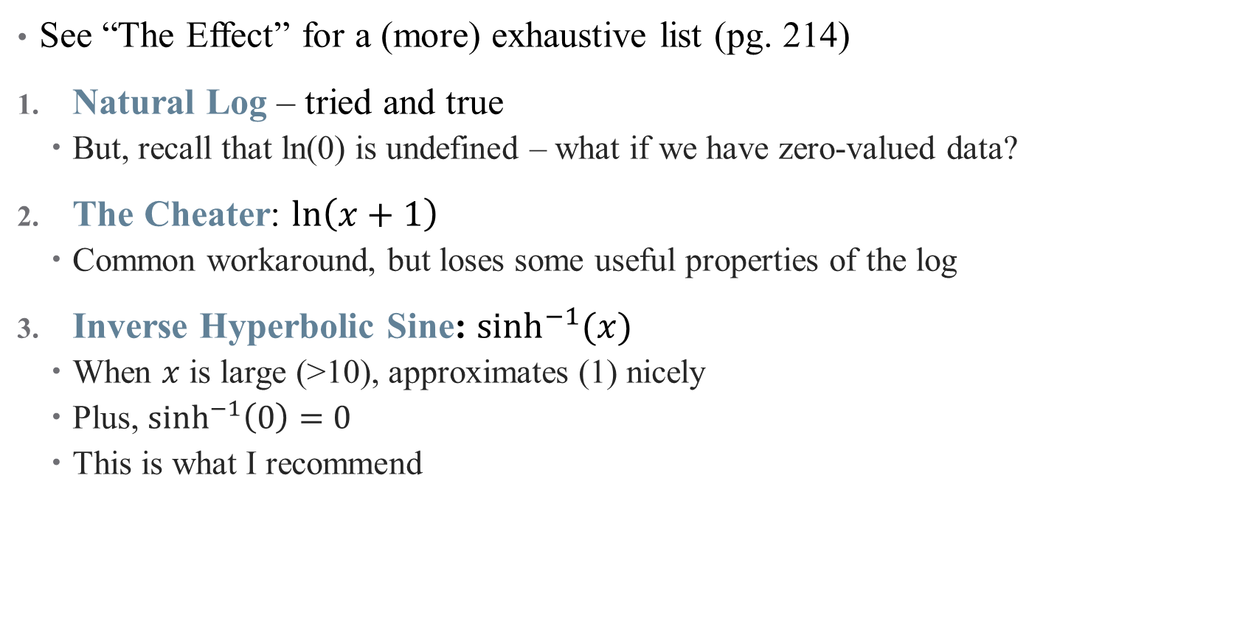
What kinds of transformations exist?
See “The Effect” for a (more) exhaustive list (pg. 214)
Natural Log – tried and true
But, recall that ln(0) is undefined – what if we have zero-valued data?
The Cheater: $ln\left(x+1\right)$
Common workaround, but loses some useful properties of the log
Inverse Hyperbolic Sine: $\sinh^{−1}{(x)}$
When $x$ is large (>10), approximates (1) nicely
Plus, $\sinh^{−1}\left(0\right)=0$
This is what I recommend
Notes:
This is the hipster one – do it and you’re cool. Can also handle negative numbers if you need

Slide 33
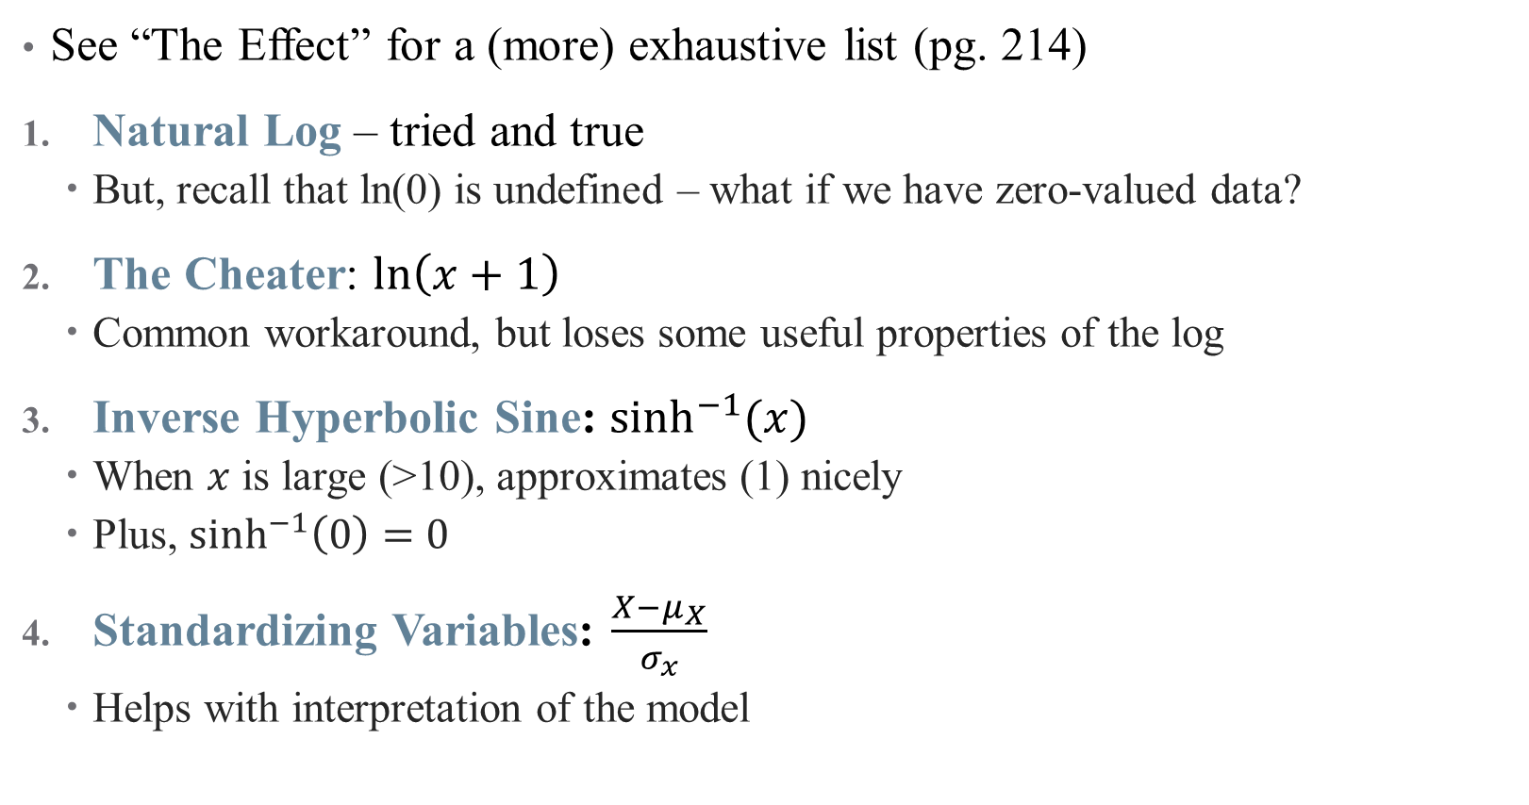
What kinds of transformations exist?
See “The Effect” for a (more) exhaustive list (pg. 214)
Natural Log – tried and true
But, recall that ln(0) is undefined – what if we have zero-valued data?
The Cheater: $ln\left(x+1\right)$
Common workaround, but loses some useful properties of the log
Inverse Hyperbolic Sine: $\sinh^{−1}{(x)}$
When $x$ is large (>10), approximates (1) nicely
Plus, $\sinh^{−1}\left(0\right)=0$
Standardizing Variables: $\frac{X−μ_{X}}{σ_{x}}$
Helps with interpretation of the model
What does our case study from last time use?
Notes:
This is a common practice if the units are already weird (e.g., points on a happiness scale), and moves to more data-driven units. (another not shown is square root)

Slide 34
Interaction Effects

Slide 35
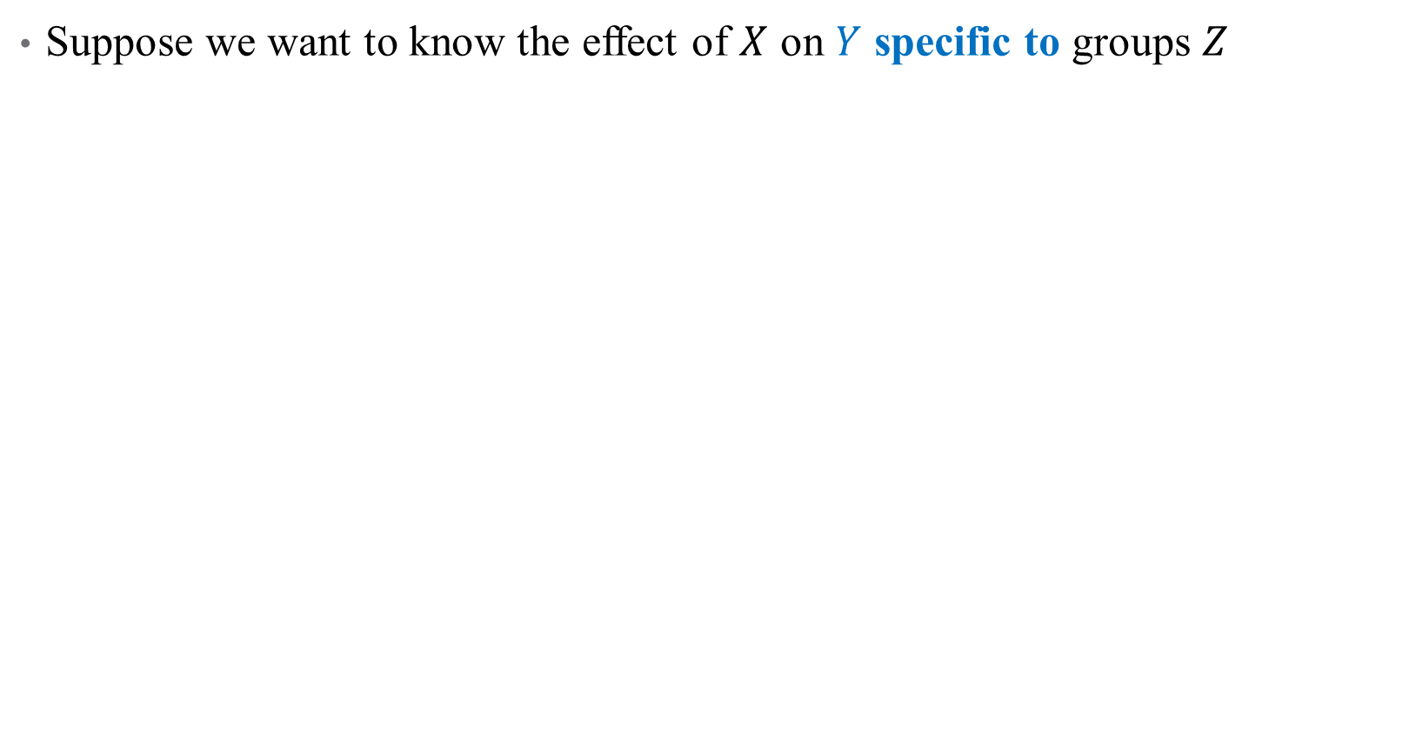
What is an Interaction?
Suppose we want to know the effect of $X$ on $Y$ specific to groups $Z$
Notes:
Example: what is the effect of radiology on survival? Well that depends on different groups of cancer patients

Slide 36
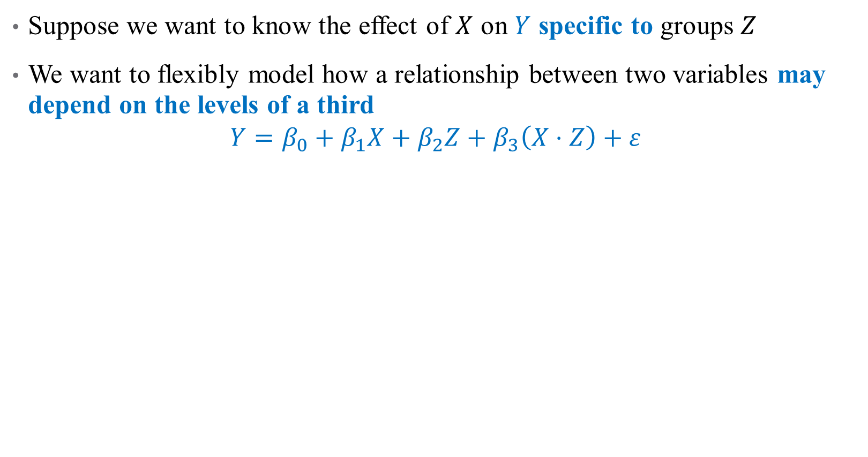
What is an Interaction?
Suppose we want to know the effect of $X$ on $Y$ specific to groups $Z$
We want to flexibly model how a relationship between two variables may depend on the levels of a third
$$Y=β_{0}+β_{1}X+β_{2}Z+β_{3}\left(X⋅Z\right)+ε$$
Notes:
We add what’s called an interaction term – here, X is the effect of radiation, and Z is an indicator variable for different type of cancer. What do each of the coefficients mean?

Slide 37
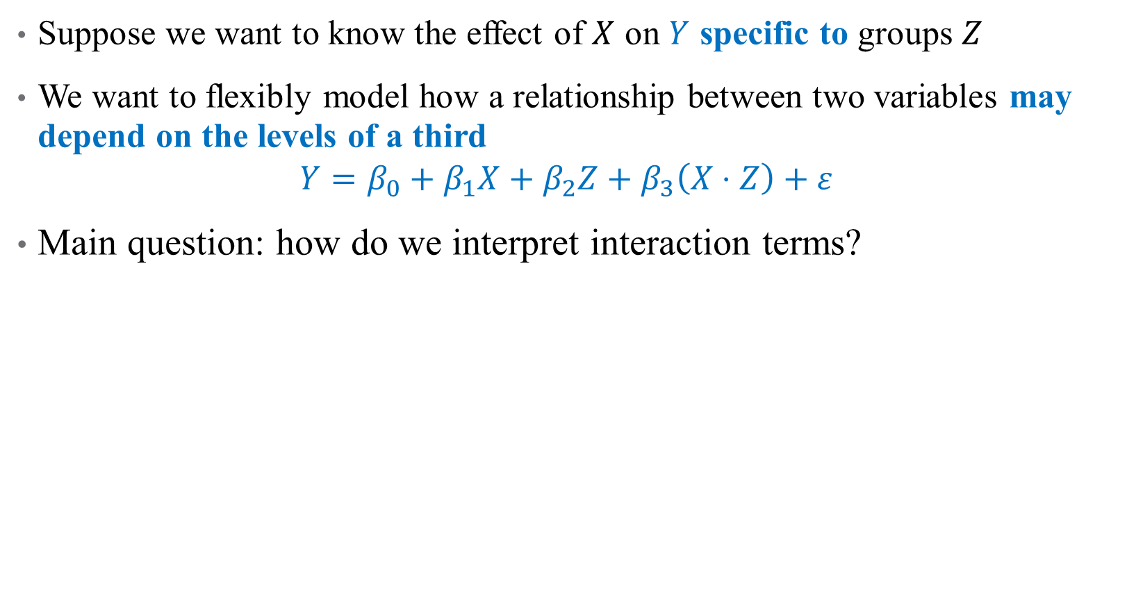
What is an Interaction?
Suppose we want to know the effect of $X$ on $Y$ specific to groups $Z$
We want to flexibly model how a relationship between two variables may depend on the levels of a third
$$Y=β_{0}+β_{1}X+β_{2}Z+β_{3}\left(X⋅Z\right)+ε$$
Main question: how do we interpret interaction terms?
Notes:
We can interpret coefs 1 and 2 easily, what about 3?

Slide 38
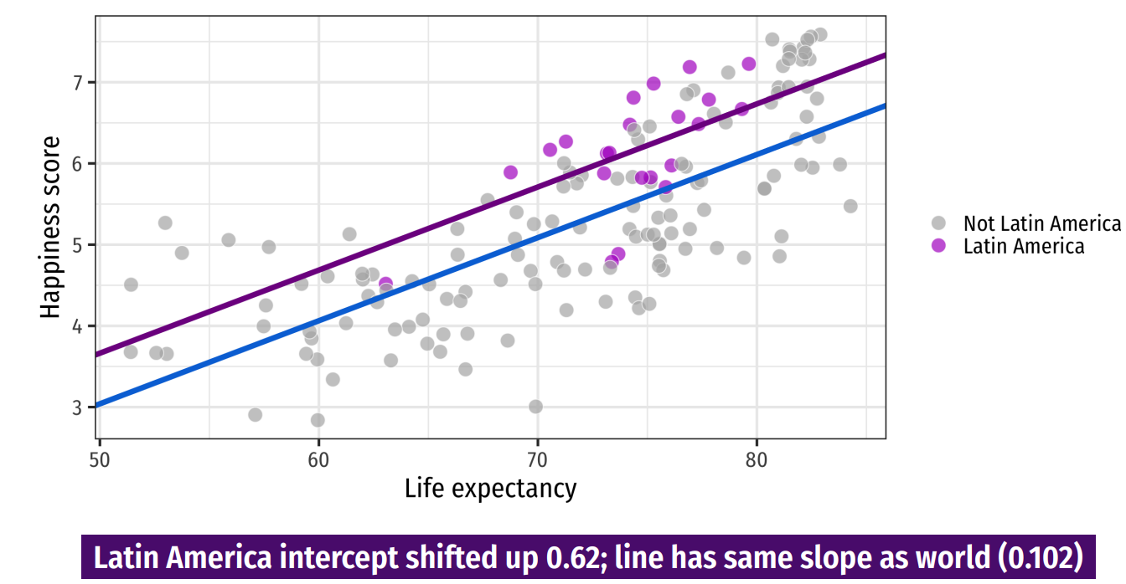
Discrete Regressors
Notes:
We don’t have an interaction model in our case study (what might it be?) so let’s circle back there. This is from last time – the impact of including a dummy is an intercept shift

Slide 39
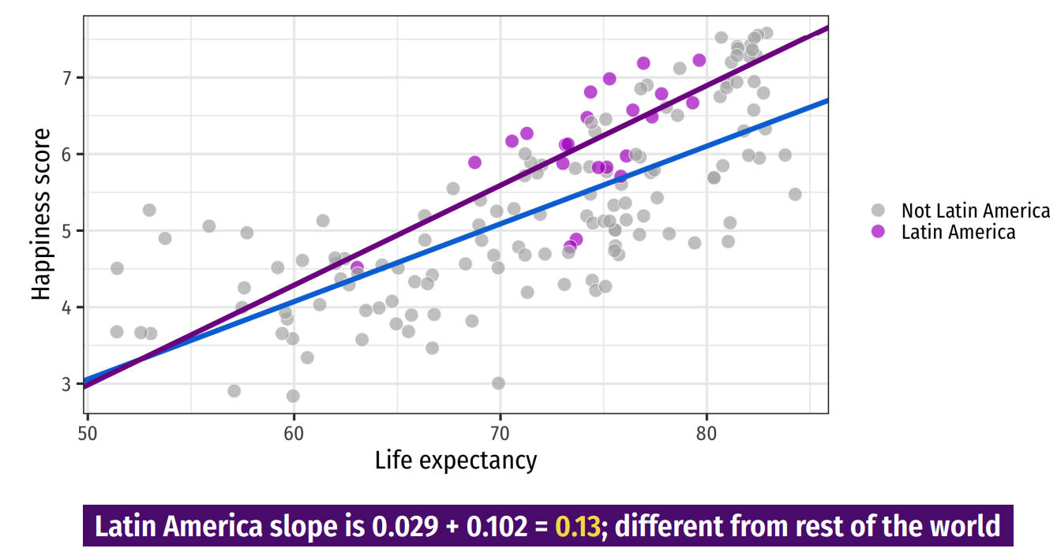
Discrete Regressors
Notes:
An interaction is a change in slope for two groups – here, we estimate happiness as a function of life expectancy * (latin America) to get separate slopes for each region. Show on board that we really have to do both.

Slide 40
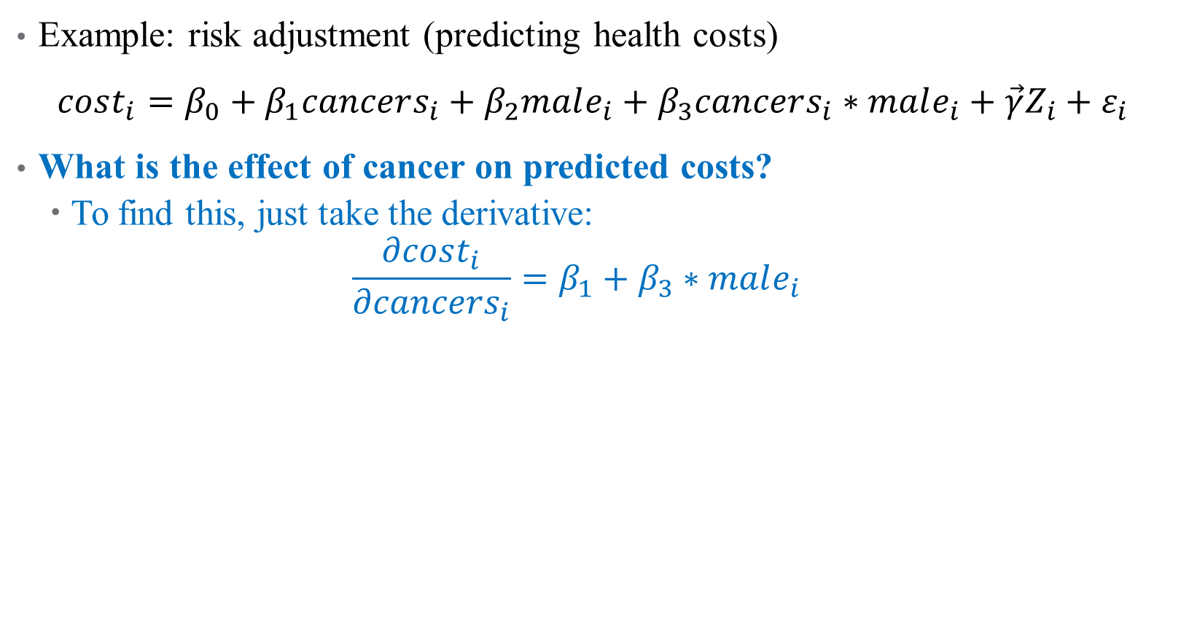
How do we Interpret Interaction Terms?
Example: risk adjustment (predicting health costs)
$cost_{i}=β_{0}+β_{1}cancers_{i}+β_{2}male_{i}+β_{3}cancers_{i}∗male_{i}+\vec{γ}Z_{i}+ε_{i}$
What is the effect of cancer on predicted costs?
To find this, just take the derivative:
$$\frac{∂cost_{i}}{∂cancers_{i}}=β_{1}+β_{3}∗male_{i}$$
Notes:
Interaction terms are everywhere in risk adjustment!

Slide 41
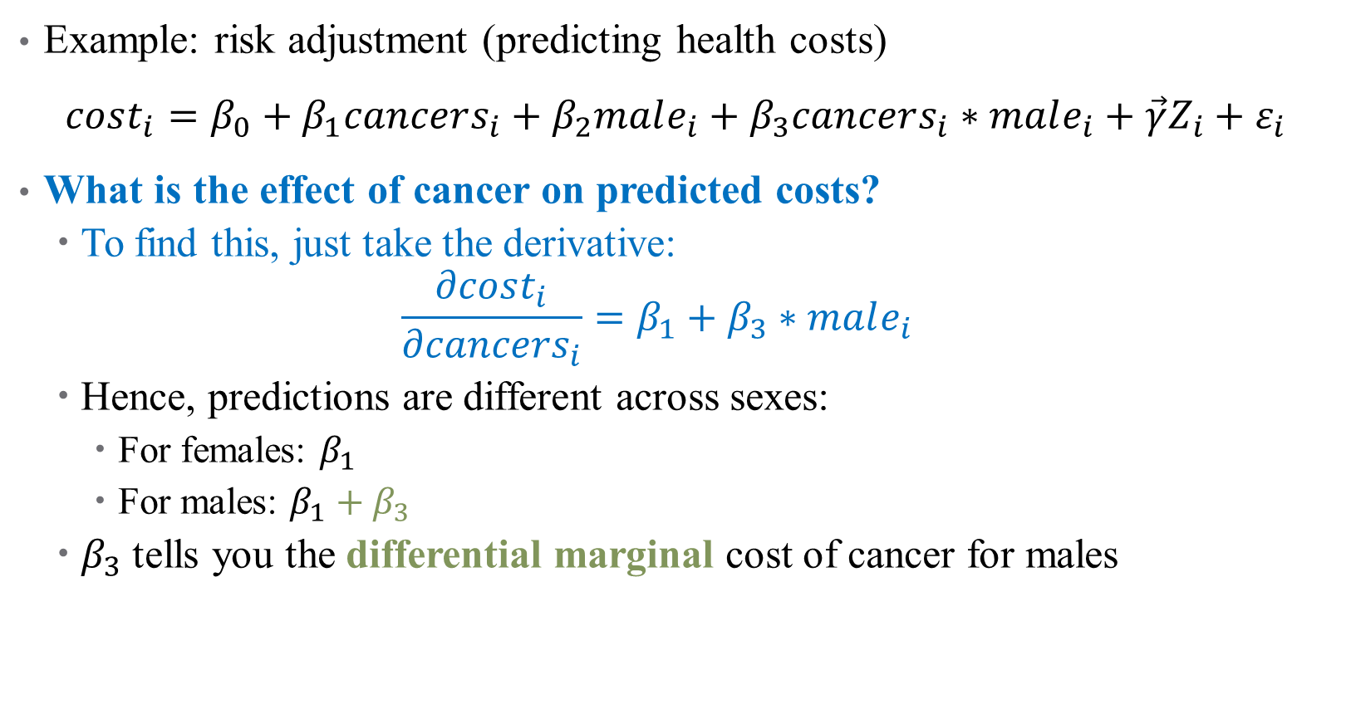
How do we Interpret Interaction Terms?
Example: risk adjustment (predicting health costs)
$cost_{i}=β_{0}+β_{1}cancers_{i}+β_{2}male_{i}+β_{3}cancers_{i}∗male_{i}+\vec{γ}Z_{i}+ε_{i}$
What is the effect of cancer on predicted costs?
To find this, just take the derivative:
$$\frac{∂cost_{i}}{∂cancers_{i}}=β_{1}+β_{3}∗male_{i}$$
Hence, predictions are different across sexes:
For females: $β_{1}$
For males: $β_{1}+β_{3}$
$β_{3}$ tells you the differential marginal cost of cancer for males
Notes:
Not just a level shift, but different margin here.

Slide 42
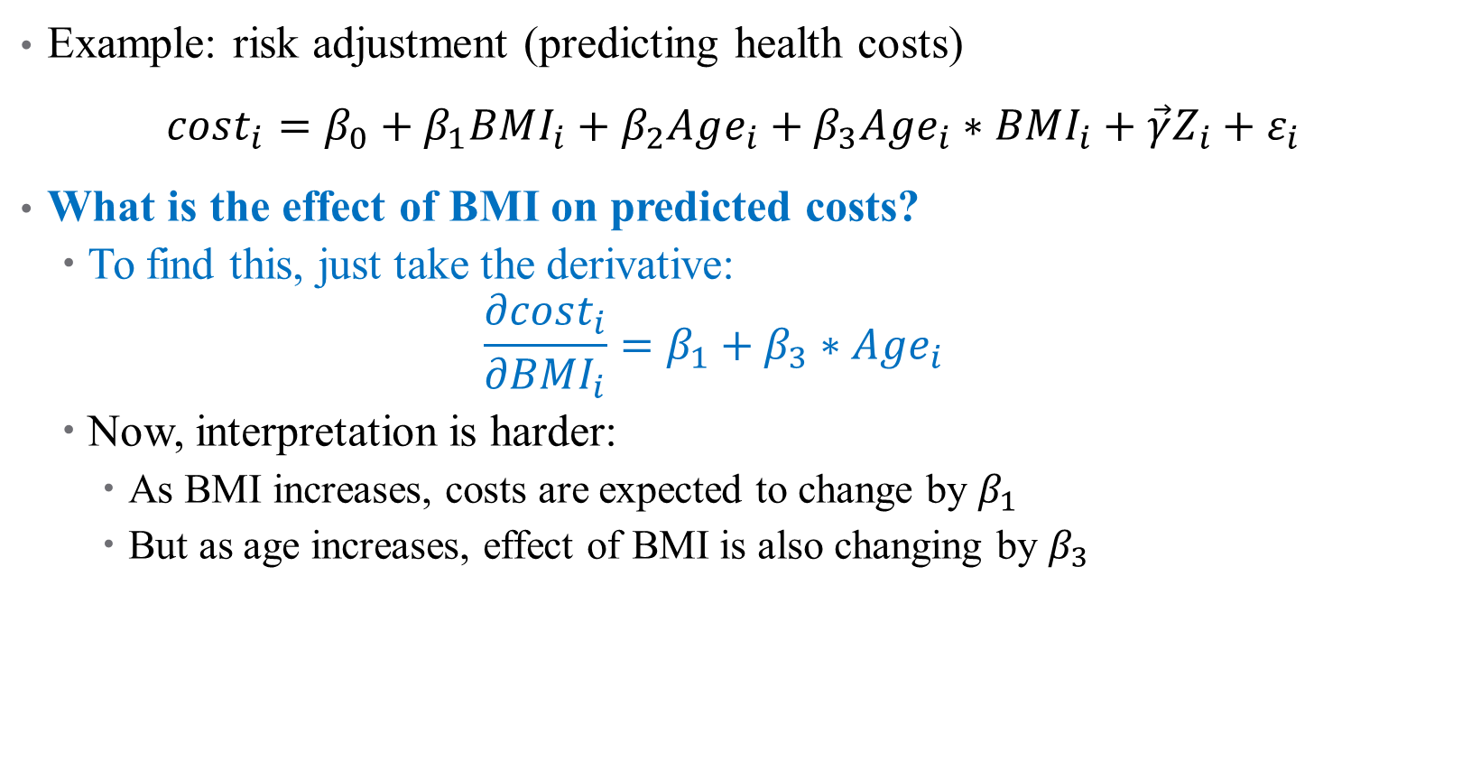
What about Continuous Interactions?
Example: risk adjustment (predicting health costs)
$cost_{i}=β_{0}+β_{1}BMI_{i}+β_{2}Age_{i}+β_{3}Age_{i}∗BMI_{i}+\vec{γ}Z_{i}+ε_{i}$
What is the effect of BMI on predicted costs?
To find this, just take the derivative:
$$\frac{∂cost_{i}}{∂BMI_{i}}=β_{1}+β_{3}∗Age_{i}$$
Now, interpretation is harder:
As BMI increases, costs are expected to change by $β_{1}$
But as age increases, effect of BMI is also changing by $β_{3}$
Notes:
Typically, interactions make more sense when one of the variables is categorical, but you can estimate this. For interpretation, you would generally “pin down” a comparison (e.g., say the change in marginal effect of BMI on costs for a 50-yo to a 60-yo)

Slide 43
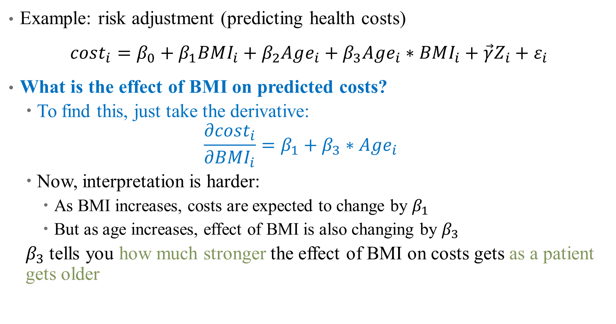
What about Continuous Interactions?
Example: risk adjustment (predicting health costs)
$cost_{i}=β_{0}+β_{1}BMI_{i}+β_{2}Age_{i}+β_{3}Age_{i}∗BMI_{i}+\vec{γ}Z_{i}+ε_{i}$
What is the effect of BMI on predicted costs?
To find this, just take the derivative:
$$\frac{∂cost_{i}}{∂BMI_{i}}=β_{1}+β_{3}∗Age_{i}$$
Now, interpretation is harder:
As BMI increases, costs are expected to change by $β_{1}$
But as age increases, effect of BMI is also changing by $β_{3}$
$β_{3}$ tells you how much stronger the effect of BMI on costs gets as a patient gets older

Slide 44
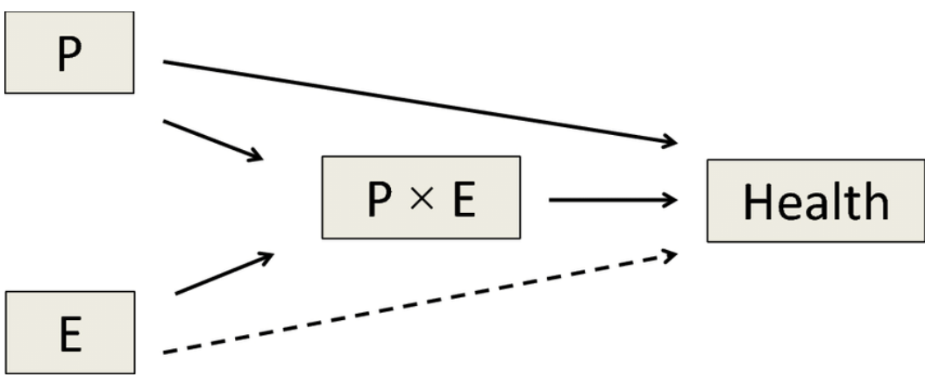
Interactions in Practice
Always include all pieces of an interaction in the full model
Much harder to interpret
Have a strong theoretical reason to justify inclusion
Too easy to get false positives
Effects are generally noisy
You’re exploiting variation across 2 noisy variables already
Will need large sample size
Notes:
Note on 1 – R will mostly do this for you, but don’t leave it up to chance. You have to do this to not keep open back doors (DAG) Note on 2: if we let the data do whatever it wants, we’ll find results that don’t mean much.

Slide 45
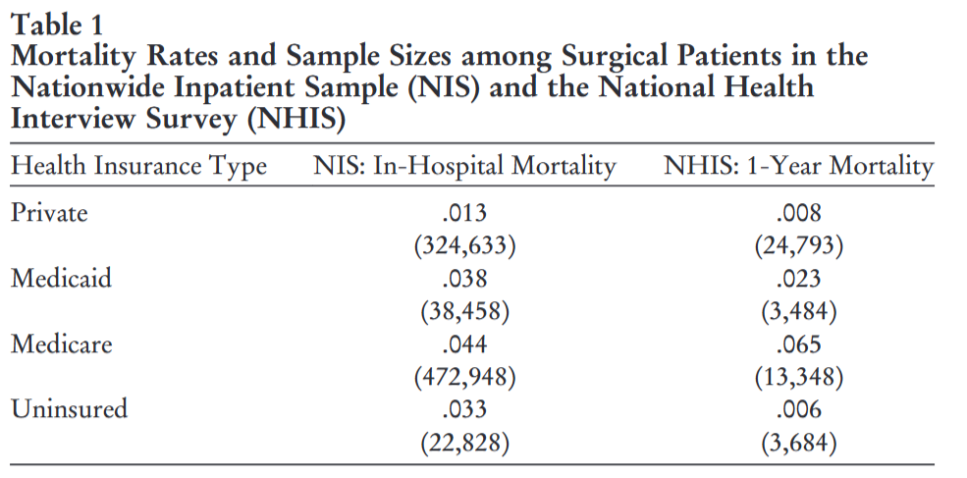
Case study: what controls are included?
Notes:
Let’s start with some descriptives here – what does this tell you? Who are these groups? Who is the adequate control group (the benchmark study they replicate uses the private insurance group, is that the right control group?)?

Slide 46
Case study: what controls are included?
Outcome: dummy variable for surgical mortality (what does this mean for context validity?)
BASE covariates include:
(linear) age
Gender
elective operative status
quartiles of mean zip code income
hospital geographic region
teaching hospital status
type of surgical operation
primary payer status
Comorbidities
Notes:
We’re going to ignore the logit bit for now and just focus on coefficient sizes.

Slide 47
Case study: what controls are included?
Outcome: dummy variable for surgical mortality (what other outcomes are studied in the replication?)
New covariates tested by the authors include:
“Full” set of ethnicity and race categories
Continuous ages
Year “fixed effects”
Citizenship status, college completion, employment status, poverty status, marital status, and smoking status
LASSO models
Weekend admission (a proxy for an unavoidable hospital visit)
“high” disease severity or mortality risk
Notes:
These include indicators for height below the25th percentile for age and sex, diabetes diagnosis before age 18, smoking initiation before age 16, current or past homelessness, and reported current mental health difficulty.

Slide 48
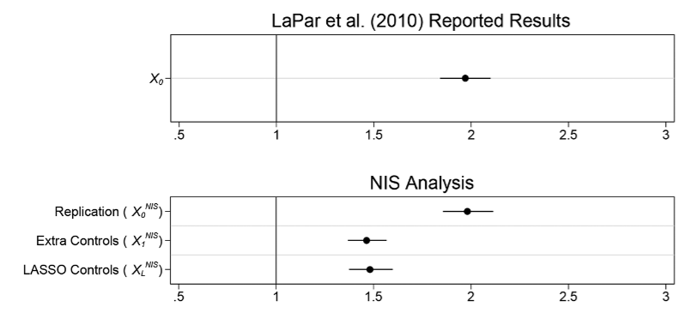
What do they find?
Notes:
Here just focusing on one of the datasets for brevity. This is just the main replication, where Medicaid patients are roughly twice as likely to die compared to privately-insured patients. The bottom panel is what happens when the authors add their controls. Why might that be true?

Slide 49
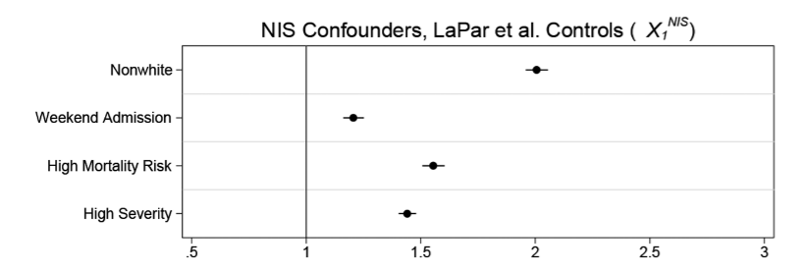
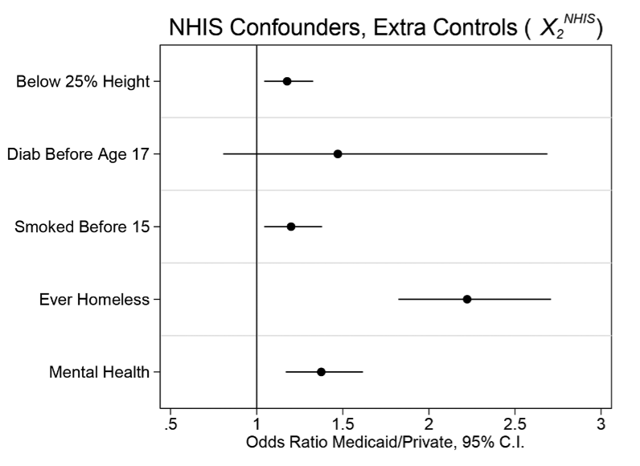
Is the comparison good?
Notes:
But the two groups aren’t even comparable after adjusting for observable covariates! What does this tell us?

Slide 50
Notes on Causality and Bias

Slide 51
Interpreting your results causally (One more time)
Remember that causality is hard!
Even after specifying your model, other things could go wrong:
Omitted Variables: missing data can bias your estimates
Measurement Error: mismeasured data can bias your estimates
Collinearity: correlation between variables can limit inferences
Notes:
We’re gonna touch on more threats to internal validity now.

Slide 52
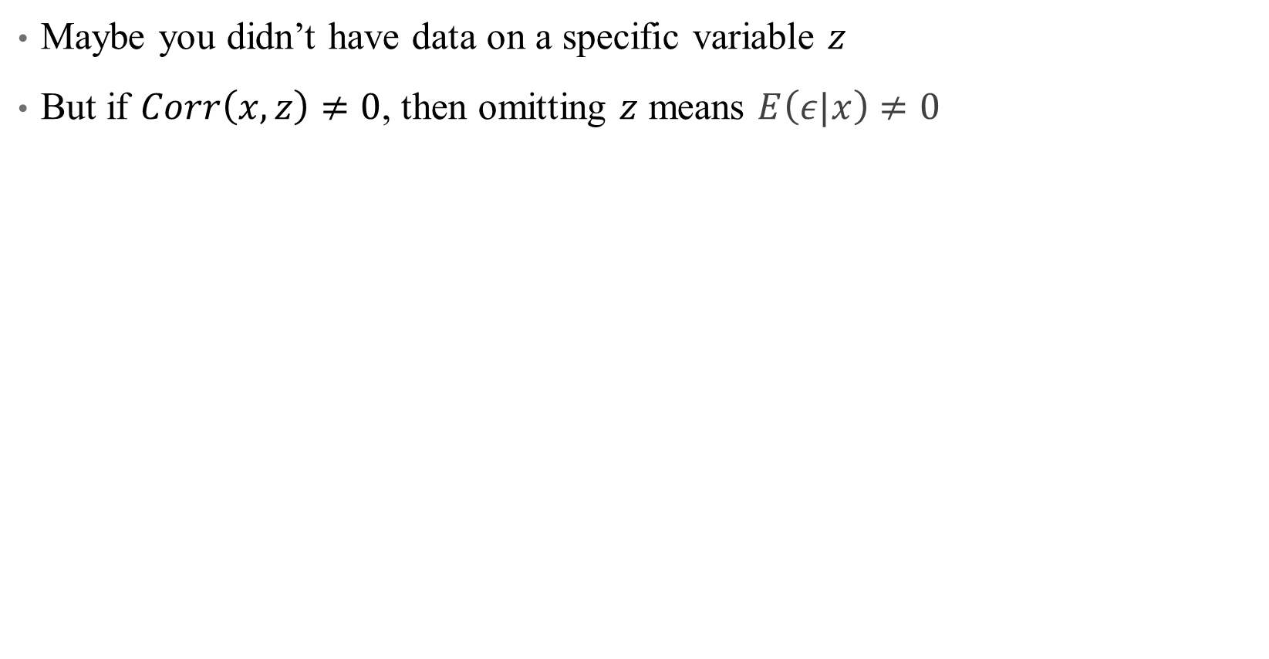
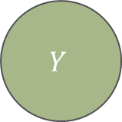
Omitted Variables
Maybe you didn’t have data on a specific variable $z$
But if $Corr\left(x,z\right)≠0$, then omitting $z$ means $E\left(ε|x\right)≠0$
X
D
$$Y$$
R
Notes:
Leaving a back door open is a big problem in design-based inference. We’ve talked about this a lot, let’s look at some math real quick.

Slide 53

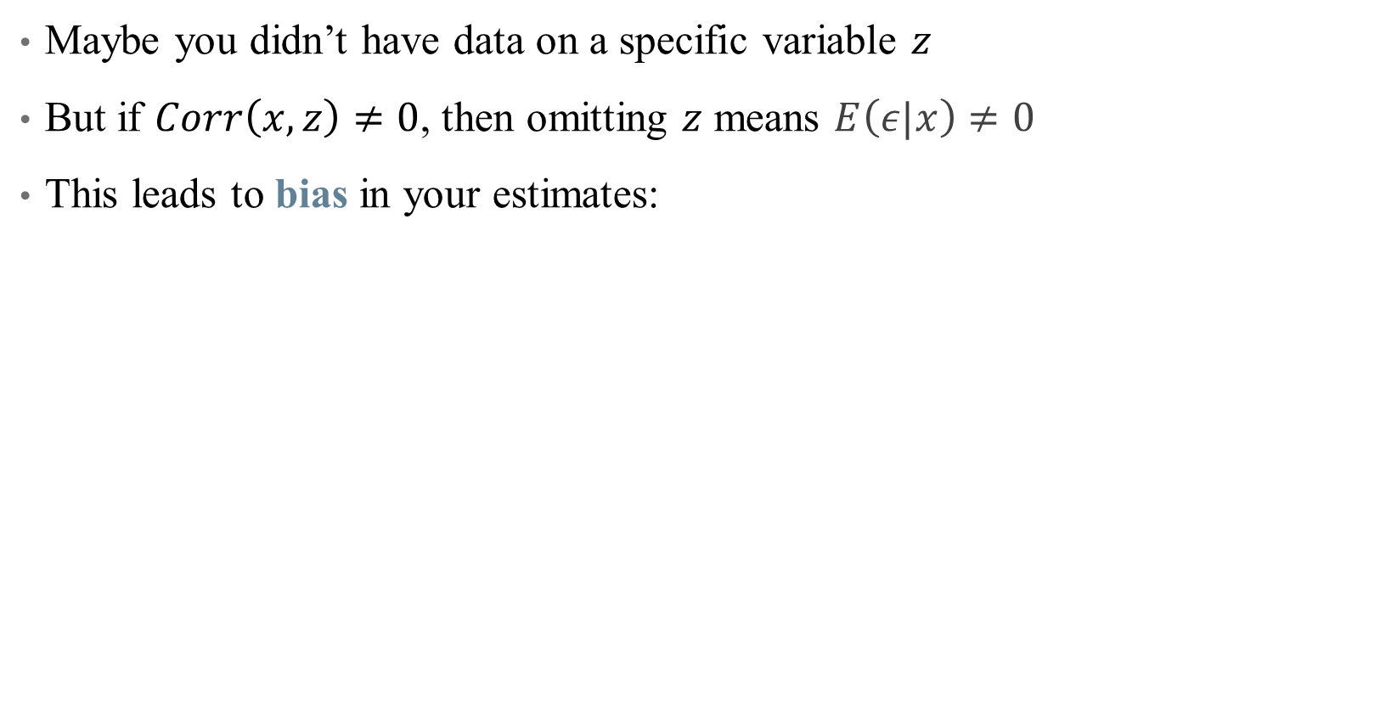
Omitted Variables
Maybe you didn’t have data on a specific variable $z$
But if $Corr\left(x,z\right)≠0$, then omitting $z$ means $E\left(ε|x\right)≠0$
This leads to bias in your estimates:
$$bias\left(\hat{β_{1}}\right)=𝔼\left[\hat{β_{1}}\right]−β_{1}$$
$$=Corr\left(x,z\right)\frac{σ_{ε}}{σ_{x}}$$

Slide 54
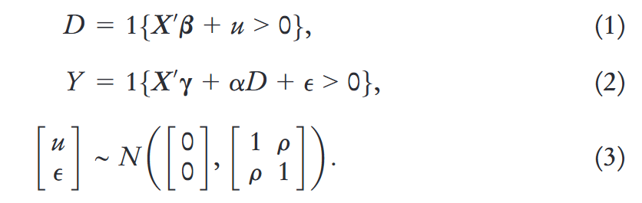
Case study: how does the correlation cause biased estimates?
Let’s think about this a different way. Suppose that we have a model predicting who gets Medicaid, and then the main regression model:
Notes:
- What is the parameter of interest? Alpha.
What goes in u? Respondents could have high values of u if they spend down their assets to qualify for Medicaid, if they have large medical bills that grant them medically needy status, if they lack employer-sponsored insurance, or if they anticipate costly health problems in the future.
What unobserved confounders are in epsilon?
What is the “identifying assumption” here in math? That error term is uncorrelated with regressors, which here means that u and epsilon are not correlated (that is, that rho = 0). Can you imagine a circumstance where “taste” for Medicaid affects mortality risk? Of course! The example in the paper is job loss.

Slide 55
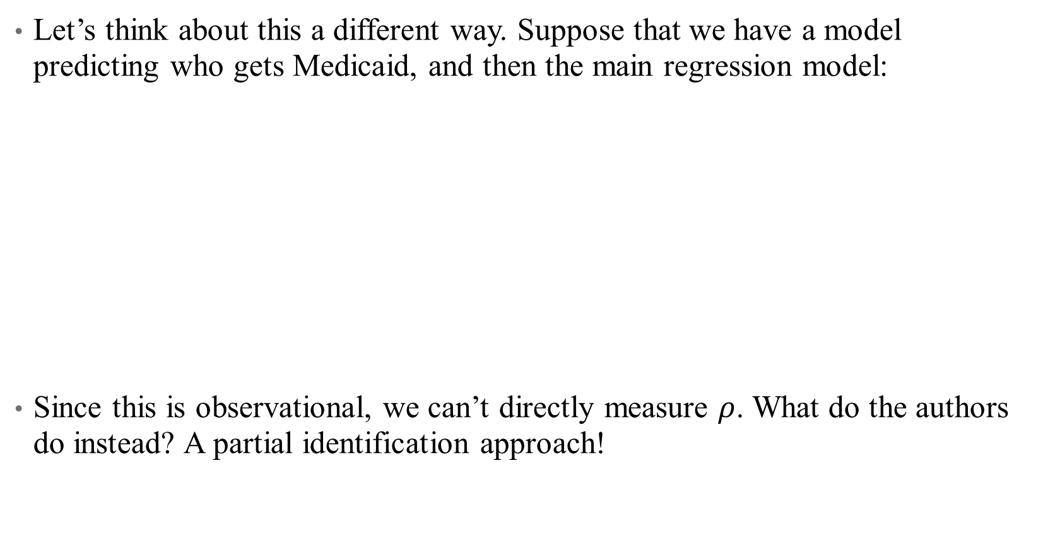
Case study: how does the correlation cause biased estimates?
Let’s think about this a different way. Suppose that we have a model predicting who gets Medicaid, and then the main regression model:
Since this is observational, we can’t directly measure $ρ$. What do the authors do instead? A partial identification approach!
Notes:
Specifically, let’s assume that rho varies and recalculate our estimates adjusting for the OVB. There is more in the paper but this is about all we have time for today.

Slide 56
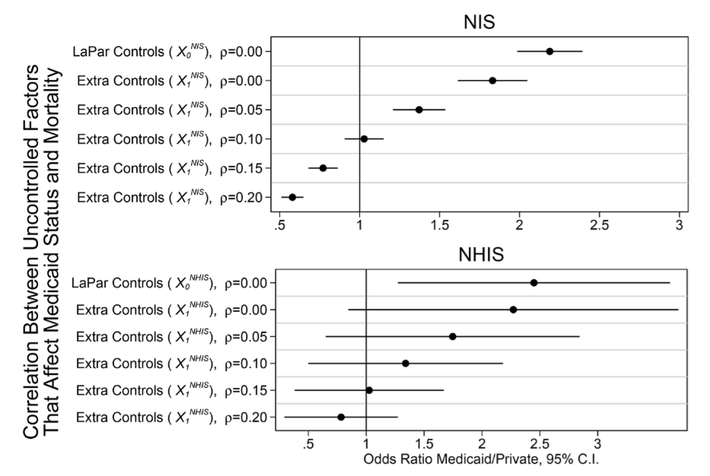
Case study: how does the correlation cause biased estimates?
Notes:
What’s the takeaway? Even small correlation = complete uninterpretability!
- Another result that is in the paper that we can’t discuss here: unobservables (like income) needed to vary only by 16%–28% as much as the observables to explain the cross-sectional relationship between Medicaid and mortality.

Slide 57
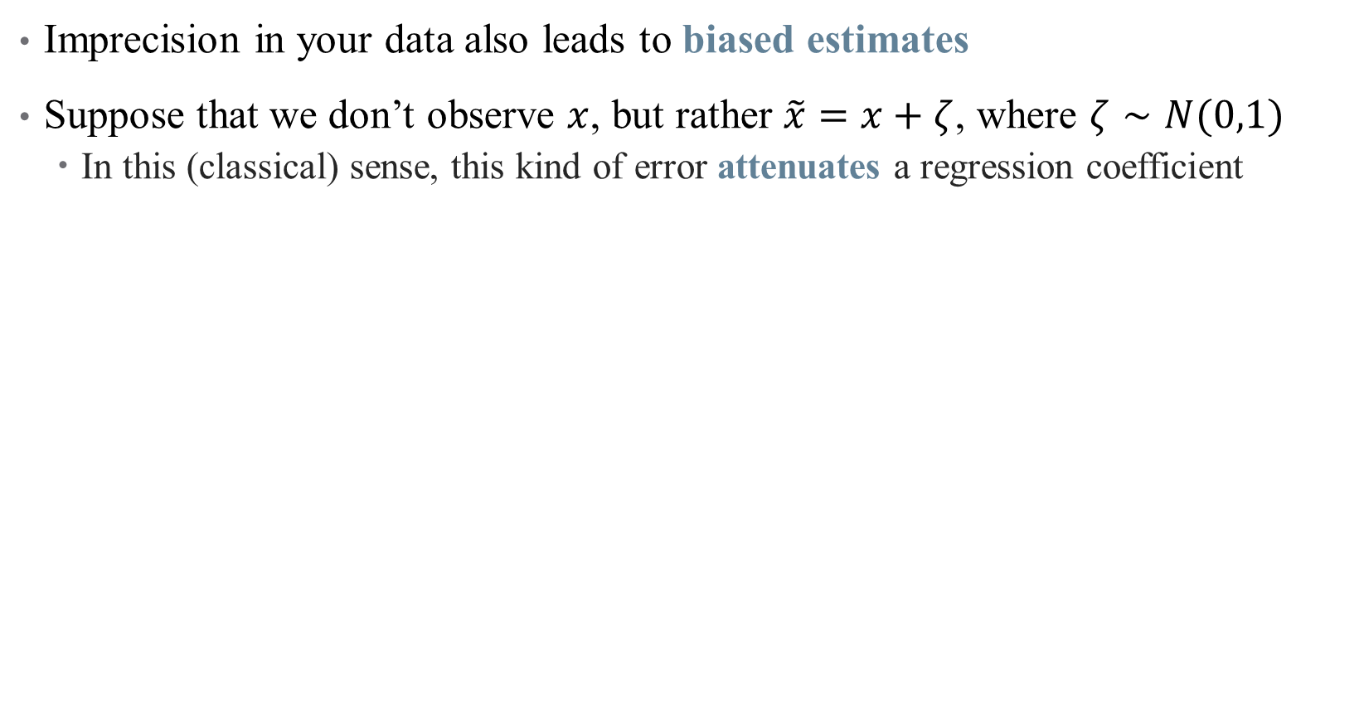
Measurement Error
Imprecision in your data also leads to biased estimates
Suppose that we don’t observe $x$, but rather $\tilde{x}=x+ζ$, where $ζ∼N(0,1)$
In this (classical) sense, this kind of error attenuates a regression coefficient
Notes:
Attenuation is a common refrain in published papers, but measurement error is more complicated than that!

Slide 58
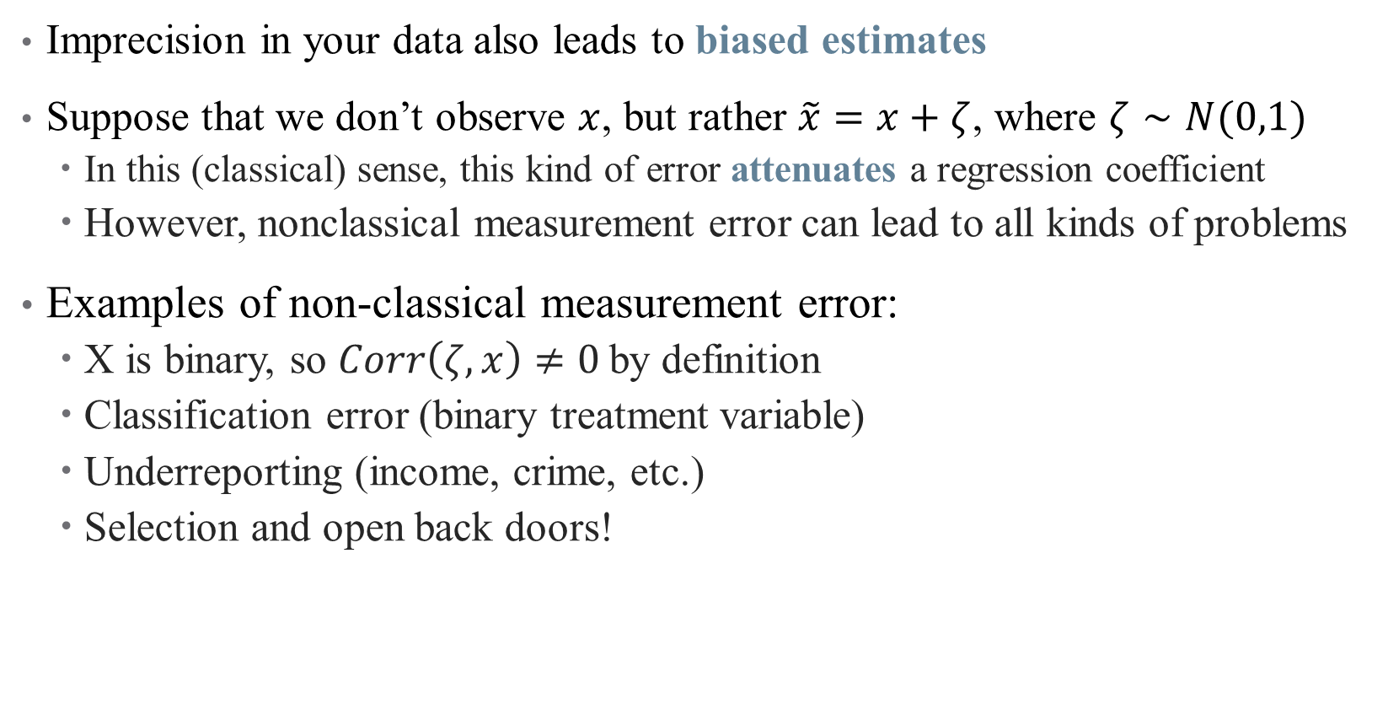
Measurement Error
Imprecision in your data also leads to biased estimates
Suppose that we don’t observe $x$, but rather $\tilde{x}=x+ζ$, where $ζ∼N(0,1)$
In this (classical) sense, this kind of error attenuates a regression coefficient
However, nonclassical measurement error can lead to all kinds of problems
Examples of non-classical measurement error:
X is binary, so $Corr\left(ζ, x\right)≠0$by definition
Classification error (binary treatment variable)
Underreporting (income, crime, etc.)
Selection and open back doors!
Notes:
What might be mismeasured in this data? The authors focus specifically on income, and show that measurement error alone could explain the results in LaPar et al.!

Slide 59
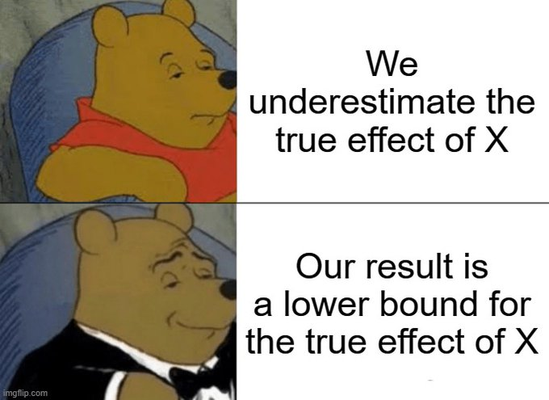
Classical Measurement Error
Notes:
But when is it really classical?

Slide 60
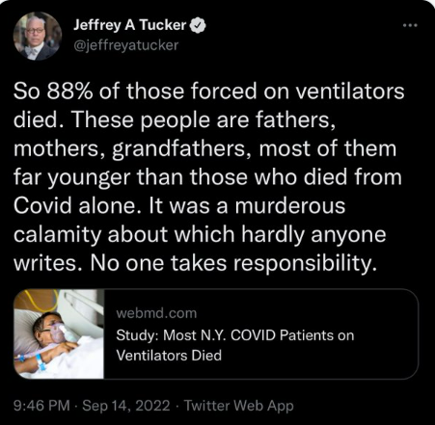
Non-Classical Measurement Error: Examples
Notes:
Measurement error can be the result of an open back door, or selection – what health examples are there?

Slide 61
Case Study example
What is the problem with how income is measured in the original Medicaid study (La Par et al., 2010)?
It’s a group-level average! This means that it necessarily groups a core average (observed) and an individual-level deviation from that average (unobserved)
The authors show that in publicly-available data, the ratio of these is:
4 times larger for unobserved deviations when using state-level data
0.3 using state, race, sex, and education categories
0.24 when we use national family income quartiles
Anything over 0.16-0.28 is likely sufficient to generate a fully spurious result
Notes:
A whole literature on risk adjustment exists to (try to) solve this issue!

Slide 62

Collinearity and Causality
Some (explanatory) variables are highly correlated, complicating inference
Notes:
If I include age and height in a regression to close back doors, how do I know what is explained by age and what is explained by height? Here, this might not matter (we just care about “growth” as the causal pathway) but what if we could consider a policy that would randomly make people taller. Would that help health? Shrugh

Slide 63

Collinearity and Causality
Some (explanatory) variables are highly correlated, complicating inference
Inclusion of irrelevant variables tends to inflate the SEs for other estimates
What’s more, if variables are too highly correlated, their effects are indistinguishable
We’ve already run into the problem of perfect collinearity (where?)
A much harder problem is near-collinearity, where $\left|ρ\left(x_{1},x_{2}\right)\right|≈1$
This is especially problematic when we care about $β_{1}$or $β_{2}$, but not both
Notes:
Where have we seen perfect collinearity? Dummy variable trap?

Slide 64

Collinearity and Causality
Some (explanatory) variables are highly correlated, complicating inference
Inclusion of irrelevant variables tends to inflate the SEs for other estimates
What’s more, if variables are too highly correlated, their effects are indistinguishable
We’ve already run into the problem of perfect collinearity
A much harder problem is near-collinearity, where $\left|ρ\left(x_{1},x_{2}\right)\right|≈1$
This is especially problematic when we care about $β_{1}$or $β_{2}$, but not both
How to diagnose this?
Look at correlation matrix of independent variables
Think about which correlations mess with your DAG
Notes:
Think about how much it really matters – collinearity is a problem if it messes with the causal parameter of interest, but doesn’t matter if age and height are both controls. What would this mean in the case study?
- Main point: when thinking about a causal regression, collinearity is an identification/data problem much more than it is a fixable one. If your main parameter is colinear with another covariate, then you can’t separate out which is causing the main effect, and that’s a fundamentally unfixable problem. The VIF adjustments, etc., aren’t helpful here. You need exogenous variation!

Slide 65
Mini Referee Report
What is the main contribution of this paper?
What does it do well?
What did it miss? What did you wish was included?
Does this paper argue that Medicaid has no effect on health?

Slide 66
Getting the “Right” Standard Errors

Slide 67

Standard Errors
Even after ensuring that the model is correctly specified, we need an idea of how precise our estimates are
Recall that $se(\hat{β_{1}})$ tells us something about sampling distribution:
Range of plausible estimates,
Confidence intervals,
Statistical significance
Eliminating certain DGPs

Slide 68

Standard Errors
Even after ensuring that the model is correctly specified, we need an idea of how precise our estimates are
Recall that $se(\hat{β_{1}})$ tells us something about sampling distribution:
Range of plausible estimates,
Confidence intervals,
Statistical significance
Eliminating certain DGPs
But the assumptions we made about $ε$ to get $se(\hat{β_{1})}$ aren’t necessarily good ones!
Key assumption: $ε_{i}$ is independent and identically distributed (i.i.d.)

Slide 69

Are my error terms i.i.d.?
Autocorrelation: “Shock” of today is correlated with “shock” from yesterday
Notes:
This is less of a problem in our data, because we rarely use time series data (which is different from panel). We’ll come back to this a little next semester – takeaway is that beta is still unbiased and inconsistent, but we will tend to overestimate significance (we need to inflate our standard errors to account for correlation)

Slide 70


Are my error terms i.i.d.?
Heteroskedasticity: Variance of distribution depends on $x$
Notes:
This is a big one for us!

Slide 71

Are my error terms i.i.d.?
Autocorrelation: Today’s “shock” today is correlated with yesterday’s
Heteroskedasticity: Variance of distribution depends on $x$
Others: Correlation within groups, multiple testing, sampling errors, etc.
Failure of $ε$ to be i.i.d. means that $se\left(\hat{β_{1}}\right)≠\sqrt{\frac{σ^{2}}{var\left(x\right)n}}$
Notes:
Multiple testing – we’ve talked about this.

Slide 72

Are my error terms i.i.d.?
Autocorrelation: Today’s “shock” today is correlated with yesterday’s
Heteroskedasticity- and autocorrelation-consistent (HAC) standard errors
Newey-West estimator, adjusts $se(\hat{β_{1}})$ based on lagged variable outcomes
Heteroskedasticity: Variance of distribution depends on $x$
Others: Correlation within groups, multiple testing, sampling errors, etc.
Failure of $ε$ to be i.i.d. means that $se\left(\hat{β_{1}}\right)≠\sqrt{\frac{σ^{2}}{var\left(x\right)n}}$

Slide 73

Are my error terms i.i.d.?
Autocorrelation: Today’s “shock” today is correlated with yesterday’s
Heteroskedasticity- and autocorrelation-consistent (HAC) standard errors
Newey-West estimator, adjusts $se(\hat{β_{1}})$ based on lagged variable outcomes
Heteroskedasticity: Variance of distribution depends on $x$
Heteroskedasticity-robust sandwich estimators
Huber-White estimator, adjusts $se(\hat{β_{1}})$ with weights for observations with large residuals
Others: Correlation within groups, multiple testing, sampling errors
Failure of $ε$ to be i.i.d. means that $se\left(\hat{β_{1}}\right)≠\sqrt{\frac{σ^{2}}{var\left(x\right)n}}$

Slide 74

Are my error terms i.i.d.?
Autocorrelation: Today’s “shock” today is correlated with yesterday’s
Heteroskedasticity- and autocorrelation-consistent (HAC) standard errors
Newey-West estimator, adjusts $se(\hat{β_{1}})$ based on lagged variable outcomes
Heteroskedasticity: Variance of distribution depends on $x$
Heteroskedasticity-robust sandwich estimators
Huber-White estimator, adjusts $se(\hat{β_{1}})$ with weights for observations with large residuals
Others: Correlation within groups, multiple testing, sampling errors
Clustered standard errors
Bootstrapped standard errors
Failure of $ε$ to be i.i.d. means that $se\left(\hat{β_{1}}\right)≠\sqrt{\frac{σ^{2}}{var\left(x\right)n}}$
Notes:
We’ll introduce robust errors – what we will usually use more is clustered robust.

Slide 75
Clustered Standard Errors
Errors might be correlated in a hierarchical structure
Example: effect of a health intervention across villages in rural area?
Different village structures mean people in same village have similar “shocks”
Errors might be correlated within villages
Notes:
Once again, we need to inflate our Ses to deal with this.

Slide 76

Clustered Standard Errors
Errors might be correlated in a hierarchical structure
Example: effect of a health intervention across villages in rural area?
Different village structures mean people in same village have similar “shocks”
Errors might be correlated within villages
There is a sandwich estimator that lets $X$ interact w/ other $Xs$ in the same group
Flexibly handles clustered standard errors!
But need to be careful how you choose the clusters
Good rule to remember: cluster at the level of the treatment
Notes:
Sandwich estimator is an econometrician’s fav thing. What do they do with standard errors in this paper? (trick question cause they don’t do anything)

Slide 77


Clustered Standard Errors
Notes:
When Should You Adjust Standard Errors for Clustering? Alberto Abadie, Susan Athey, Guido W. Imbens, and Jeffrey Wooldridge (metrics avengers)

Slide 78


Clustered Standard Errors
Notes:
How do you choose what to cluster?

Slide 79


Clustered Standard Errors
Notes:
Main takeaways – cluster at the highest level (e.g., state, not county), but carefully consider when you should cluster (a Type II error is just as bad as a Type I). One rule when you should cluster: fixed effects + treatment heterogeneity.

Slide 80

Bootstrapped Standard Errors
One of the most powerful tools in statistics!
If we want to learn something about the sampling distribution, why not just take a bunch of samples and see how our estimates vary?
These are very useful for estimating $se(\hat{β_{1}})$ in unusual cases!
A couple caveats
Needs large sample sizes to work well
Can’t completely handle autocorrelation

Slide 81
Bootstrapped Standard Errors
One of the most powerful tools in statistics!
Start with a data set with observations.
Randomly sample observations from that data set, allowing the same observation to be drawn more than once. This is a “bootstrap sample.”
Estimate our statistic of interest using the bootstrap sample.
Repeat steps 1-3 a whole bunch of times.
Look at the distribution of estimates from across all the times we repeated steps 1-3. The standard deviation of that distribution is the standard error of the estimate. The 2.5th and 97.5th percentiles show the 95% confidence interval, and so on.

Slide 82
Nonlinear Models (pt. 1)
Notes:
Skip this bit if you want – or defer to appendix for future slides.

Slide 83

Nonlinearities
Sometimes, a linear model isn’t enough (even after transformations)

Slide 84
Could we transform this data?
When data can be transformed to accommodate linear relationships, do it
Otherwise, add polynomial terms!

Slide 85

Choosing a Functional Form
OLS can accommodate regressions of the form:
$$y=β_{0}+β_{1}x+β_{2}x^{2}+β_{3}x^{3}+ …+\vec{γ}Z+ε$$
Still linear in parameters
As in interaction terms, never omit an intermediate power
That is, don’t add a cubic term without a quadratic one
Notes:
Remember, OLS is linear in parameters (not necessarily in data) – it just depends how you plan to interpret the parameters of the funky data you’re giving OLS

Slide 86

Choosing a Functional Form
OLS can accommodate regressions of the form:
$$y=β_{0}+β_{1}x+β_{2}x^{2}+β_{3}x^{3}+ …+\vec{γ}Z+ε$$
Still linear in parameters
As in interaction terms, never omit an intermediate power
That is, don’t add a cubic term without a quadratic one
Changing functional forms may yield a better fit, but also changes interpretation of the coefficients.

Slide 87

How do we Interpret Coefficients?
OLS can accommodate regressions of the form:
$$y=β_{0}+β_{1}x+β_{2}x^{2}+β_{3}x^{3}+ …+\vec{γ}Z+ε$$
Changing functional forms may yield a better fit, but also changes interpretation of the coefficients.
$$\frac{∂y}{∂x}=β_{1}+2β_{2}⋅x+3β_{3}⋅x^{2}+ …$$
Now, marginal effects depend on levels of $x$
Notes:
So what exactly do you do here? Have to generally pick a level of x (mean, for example) for this to make sense.

Slide 88

How do we Interpret Coefficients?
OLS can accommodate regressions of the form:
$$y=β_{0}+β_{1}x+β_{2}x^{2}+β_{3}x^{3}+ …+\vec{γ}Z+ε$$
Changing functional forms may yield a better fit, but also changes interpretation of the coefficients.
$$\frac{∂y}{∂x}=β_{1}+2β_{2}⋅x+3β_{3}⋅x^{2}+ …$$
Now, marginal effects depend on levels of $x$
Another caution: overfitting
How much randomness in the data do we want to add to our model?
How much complication in our marginal effects are we willing to tolerate?
See discussion on LASSO, etc. for automated inclusion

Slide 89

What do my results mean?
Types of causal validity
Construct validity: are we measuring what we want to measure?
How is the outcome variable measured?
Are we capturing the right spot in the distribution (mean, median, etc.?)
Notes:
This is also known as the street light effect – researchers shine the light just on the street, miss what’s to the side. Are you asking the right questions? An example: a program hopes to improve commitment to school, and boasts that it improves test scores -- does that measure the outcome you want (teacher performance, kid happiness, etc.?) or does it just measure how good kids are at taking tests. Data limitations play a big role here (in health, think quality measurements, or metrics of risk/equity/etc.)
- An example to walk through: self-reported health measures. Suppose you have a Likert scale, how can we make this work and interpret it? What do we learn if it’s continuous? What do we learn if its binary?

Slide 90
What do my results mean?
Types of causal validity
Construct validity: are we measuring what we want to measure?
Statistical validity: are your statistics correct?
Do you have enough statistical power to get the results that you want?
Are all of your required assumptions met?
Was there any p-hacking involved in getting the answer you published?
Are your associations causal or spurious correlation?
Notes:
These are questions that are nearly impossible to answer in a paper or project (okay, you can do a power calculation – ish). But you still need to think carefully about each of these.
example: what about how the authors adjust for income? Good enough?

Slide 91

Statistical Power
Notes:
If you sample a small group repeatedly, you get a lot of different answers. But if you sample a large group even fewer times, your effects are more noticeable. Power calculations can tell you something about what the sample size should be (going out the window with big data)

Slide 92

How do I report my results and assumptions?
The TRIPOD Checklist has useful structure on what you should be watching out for
Notes:
Also includes things like – what limitations should be noted, what should go in a discussion, etc. We’ll try to talk more about this with each method we cover.

Slide 93

Are my results hacked? Are they spurious?
Notes:
For p-hacking, remember the website: https://projects.fivethirtyeight.com/p-hacking/. Did you correct for multiple testing? Did you perform 20 tests and report the one significant result?

Slide 94

Aggregate p-hacking: Publication Bias
Notes:
Distribution of p-values in research – what does this tell you? (Note that the z-stat is the test statistic, the inverse of the p-value)

Slide 95
What do my results mean?
Types of causal validity
Construct validity: are we measuring what we want to measure?
Statistical validity: are your statistics correct?
Internal validity: are your mechanisms correct?
Did you pick up the causal pathway you wanted?
Lots of threats!
Selection, omitted variable bias, attrition, seasonality, measurement error, spillovers
Each of these can affect your results
Notes:
Economists call internal validity “identification” You might not even have seen all the threats if your DAG is incomplete or wrong. A good econometrician is trained to try to pick at all the potential threats to identification / internal validity here. The best way to get around these is to think about as many as you can and then present your work as much as you can – people will help you see what you’re missing.
- Example here: are crop losses truly exogenous to the household? Can you see any reason why they might not be?

Slide 96

Example of Selection Bias: Marriage and Happiness
Notes:
Cover this example if you have time.

Slide 97

Example of Selection Bias: Marriage and Happiness
Notes:
Cover this example if you have time. Comparison between age of marriage and reported happiness (note: think about construct validity here too, with happiness scores). The selection is those choosing to be married in time sample, but could there be other threats?

Slide 98

Example of Selection Bias: Marriage and Happiness
Notes:
What threats are there to this (selection into early marriage, etc.)

Slide 99

Example of Selection Bias: Marriage and Happiness
Notes:
The authors tried to compare based on relative years around marriage, but look: happiness ticks up before marriage – so it can’t be from marriage! Of course, there are problems with this design (end of semester).
We will talk about more internal validity threats next time as well.

Slide 100
What do my results mean?
Types of causal validity
Construct validity: are we measuring what we want to measure?
Statistical validity: are your statistics correct?
Internal validity: are your mechanisms correct?
External validity: are your findings generalizable?
Are your results a fluke of a limited sample?
Notes:
We’ll talk about more threats to internal validity throughout the course, particularly next time. If you want to think about multiple threats to IV, just think about nutrition research (they’re everywhere!)
- example: does this apply to Latin America? Current Mexico? How should we think about this?

Slide 101

Example of External Validity
Notes:
Um what? Don’t trust the headlines, or the lay media.

Slide 102

Example of Selection Bias: Marriage and Happiness
Notes:
True story: this was a study published about mice! But read the text summarizing the study.

Slide 103

What do my results mean?
Types of causal validity
Construct validity: are we measuring what we want to measure?
Statistical validity: are your statistics correct?
Internal validity: are your mechanisms correct?
External validity: are your findings generalizable?
Are your results a fluke of a limited sample?
Does your data match the population?
Notes:
Particularly of concern with surveys or even clinical trials

